Slide 1
A Data-driven Bayesian Approach to Automatic Rhythm Analysis of Indian Art Music
17 Nov 2016, PhD defense
Ajay Srinivasamurthy
Dept. of Information and Communication Technologies
Universitat Pompeu Fabra
Thesis Supervisor Thesis Committee:
Dr. Xavier Serra Dr. Simon Dixon (QMUL)
Music Technology Group Dr. Geoffroy Peeters (IRCAM)
Universitat Pompeu Fabra Dr. Juan Pablo Bello (NYU)
Notes:
Thank you and welcome. I am going to present the work done as a part of the thesis titled, which has been carried out under the supervision of Prof. Xavier Serra

Slide 2


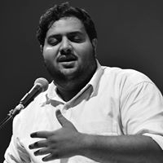






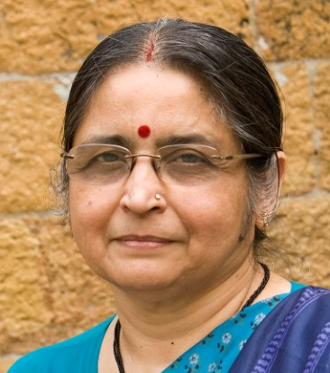


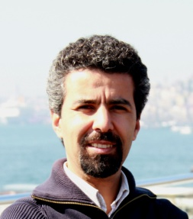
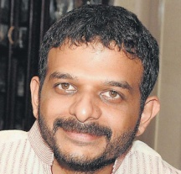




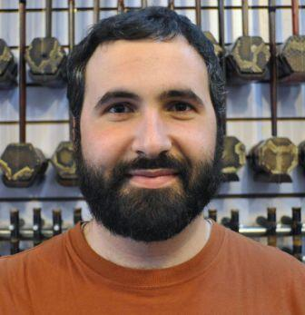


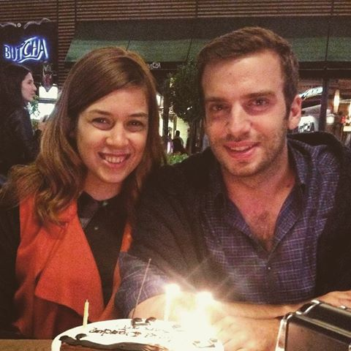
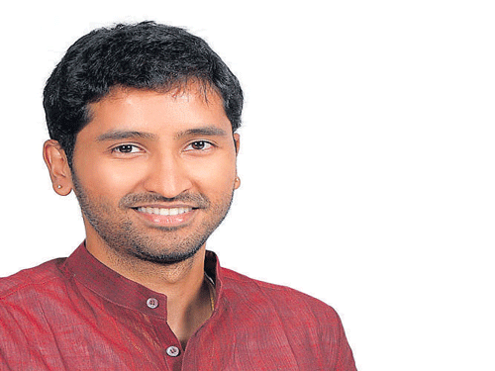



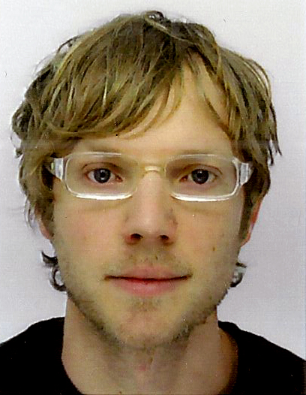
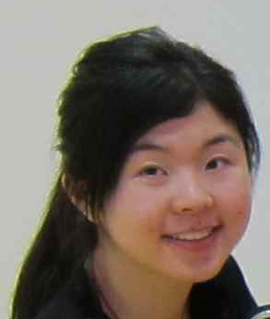

Acknowledgements
Notes:
Before I begin, I would like to thank Dr. Xavier Serra for the opportunity. It has been a great and memorable stay at MTG.
I would like to specially thank Dr. Andre Holzapfel, who is also here and has a major role in the thesis. I would like to thank all the numerous co-authors and collaborators who have contributed to the thesis. I also would like to thank the members jury for taking out their time and agreeing to review the thesis, and all of you present here.

Slide 3
Outline
Introduction
Background
Research problems
Data corpora
Meter inference and tracking
Percussion pattern discovery
Summary

Slide 4
Introduction

Slide 5
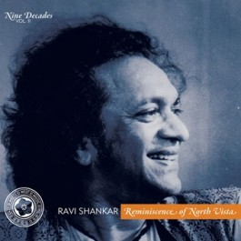
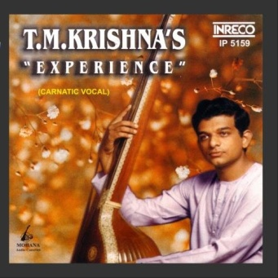
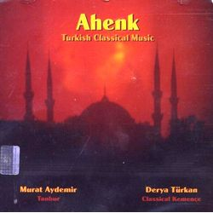
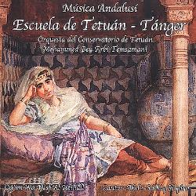

Context – CompMusic
Information technologies in a multicultural world
Culture aware Music Information Research (MIR)
Focus on rhythm
Hindustani
Carnatic
Turkish-makam
Arab-Andalusian
Beijing Opera
http://compmusic.upf.edu/
Notes:
The thesis has been carried out within the context of the CompMusic project, which aims to build culture-aware music information research technologies in our multicultural world. This thesis focuses on rhythm.

Slide 6
Motivation – Automatic rhythm analysis
Rhythm is a fundamental dimension of music
Rhythmic structures and patterns
Rhythm similarity
Applications
Enriched listening
Meaningful interaction with large collections of music
Notes:
The motivation for the thesis is automatic rhythm analysis and its applications. Rhythm is a fundamental dimension of music and an analysis of rhythmic structures and patterns would help us to define rhythm similarity measures, that can be variously used for enriched music listening and for meaningful interaction with large collections of music.

Slide 7
Scope and Objectives – Long title
Culture-aware and data-driven
signal processing and machine learning approaches for
automatic analysis, description and discovery of rhythmic structures and patterns in
audio music collections of Indian art music
Sec 1.3
Notes:
The scope and objectives of the thesis can be made clear using this long title of the thesis – it’s too long, so let’s break it down.

Slide 8
… automatic analysis, description and discovery …
Automatic rhythm analysis and description
No focus on synthesis or composition
Culture-aware and data-driven signal processing and machine learning approaches
for automatic analysis, description and discovery of rhythmic structures and patterns in audio music collections of Indian art music
Sec 1.3
Notes:
The core of the thesis are the tasks of automatic analysis, description and discovery. Synthesis and composition are not addressed.

Slide 9
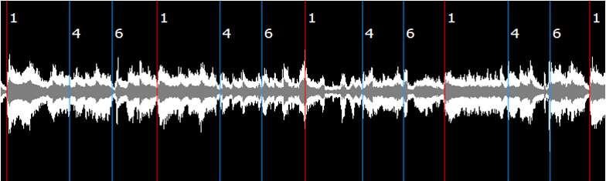
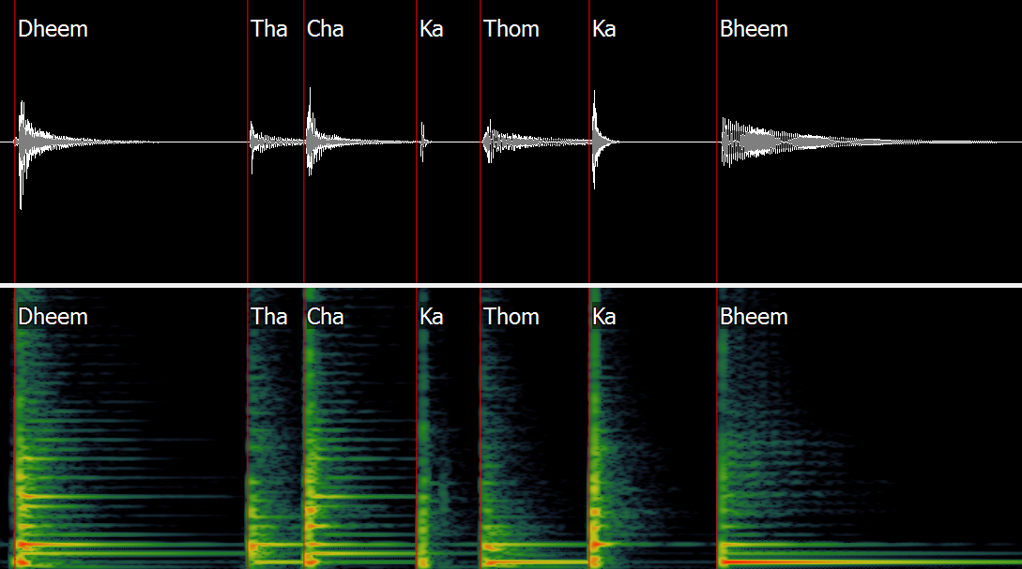
. . . of rhythmic structures and patterns . . .
Analysis of metrical structures
Discovery of rhythm and percussion patterns
Culture-aware and data-driven signal processing and machine learning approaches
for automatic analysis, description and discovery of rhythmic structures and patterns in audio music collections of Indian art music
Sec 1.3
Notes:
Of rhythmic structures and patterns, where we want to analyze metrical structures and discover percussion patterns.

Slide 10
Culture-aware and data-driven . . .
Culture-aware
Work within CompMusic and its community
Bring music knowledge into methods
Musical concepts to engineering formulations
Data-driven engineering approaches
Emphasis on data and methods
Culture-aware and data-driven signal processing and machine learning approaches
for automatic analysis, description and discovery of rhythmic structures and patterns in audio music collections of Indian art music
Sec 1.3
Notes:
How do we want to do it: we take a culture-aware approach, where we work within a music community and bring that music knowledge into methods, converting music concepts to engineering formulations. The thesis is an engineering thesis involving data-driven approaches and hence the focus is on data and methods.

Slide 11
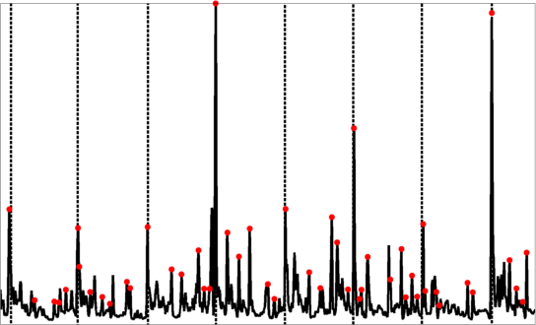
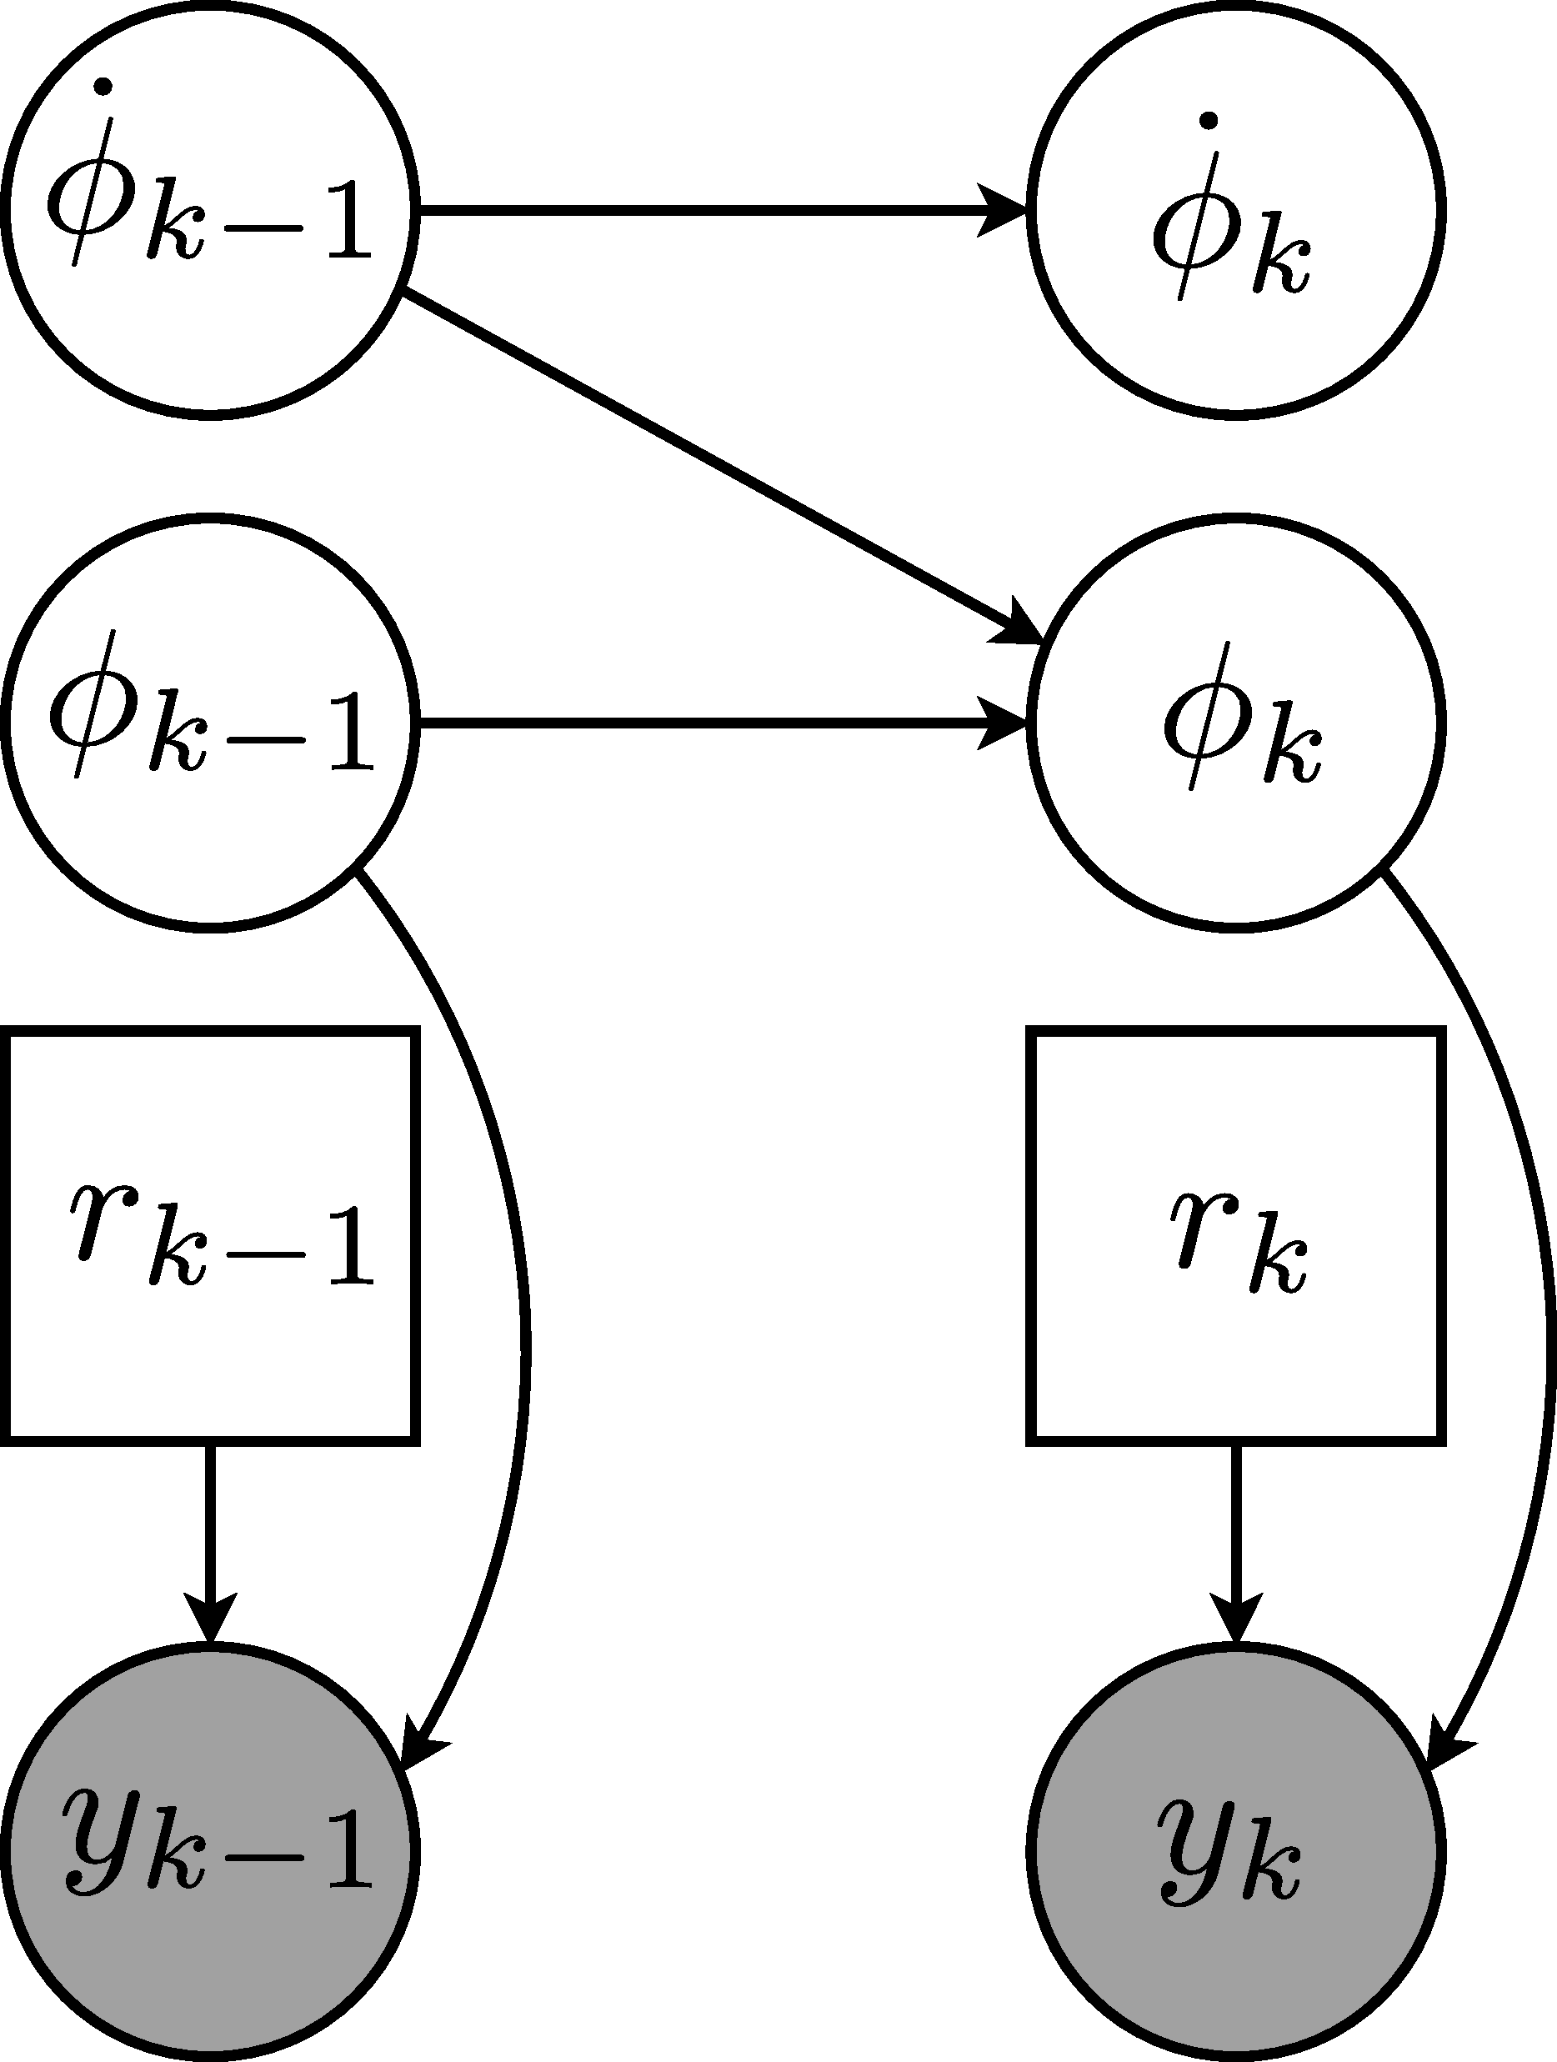
. . . signal processing and machine learning approaches . . .
Informed signal processing
Bayesian machine learning methods
Generative models – explicitly include music knowledge
Novel methodologies for analysis and discovery
Culture-aware and data-driven signal processing and machine learning approaches
for automatic analysis, description and discovery of rhythmic structures and patterns in audio music collections of Indian art music
Sec 1.3
Notes:
The tools we use are informed signal processing and machine learning, where we use Bayesian machine learning methods, which can explicitly include music knowledge in concrete ways to develop novel methods for analysis and discovery.

Slide 12
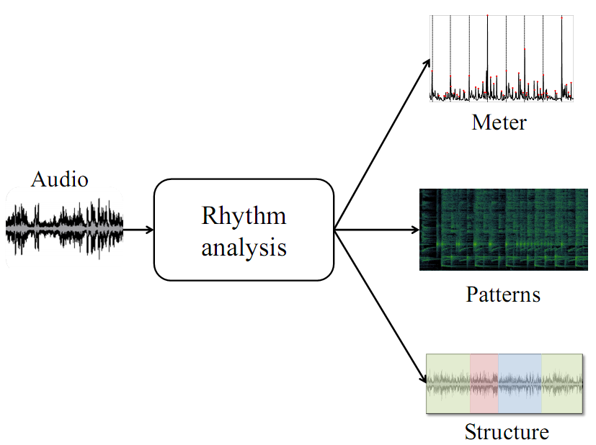
. . . audio music collections . . .
Audio music collections
An audio recording is at the centre of analysis
Use additional metadata
Culture-aware and data-driven signal processing and machine learning approaches
for automatic analysis, description and discovery of rhythmic structures and patterns in audio music collections of Indian art music
Sec 1.3
Notes:
The core object of analysis is an audio recording from collections of music, while we use additional metadata from different sources to complement the methods.

Slide 13
. . . Indian art music
The focus is on Indian art music
Well-studied with significant musicological literature
A large audience
Unique challenges
Identifying challenges and opportunities
Extensions to other music cultures
Culture-aware and data-driven signal processing and machine learning approaches
for automatic analysis, description and discovery of rhythmic structures and patterns in audio music collections of Indian art music
Sec 1.3
Notes:
The music culture of focus is Indian art music since it is well studied and has a significant musicological literature, a large audience and comes with unique challenges identifying which is one of the tasks of the thesis. Extensions to other music cultures is also explored to a limited extent.

Slide 14
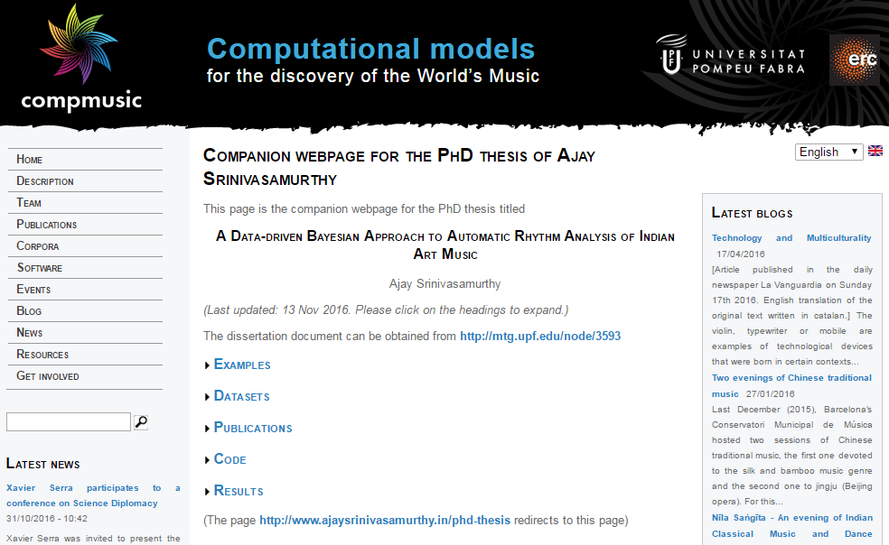
Additionally . . .
Emphasis on reproducible and open research
Code – Open source, Data – Easily accessible
Sec 1.3
Notes:
Additionally, there is an emphasis on open research, with open code and when possible, easily accessible and open data.

Slide 15
Primary research questions
Data corpora for MIR
Musicological insights on music performance
Culture-aware specialized approaches
Utility of the explicit use of music knowledge
Sec 1.3
Notes:
We wish to broadly address two research questions: first on data, wherein we wish to see if any musically valid inferences can be drawn from computational analysis of data.

Slide 16
Primary research questions
Data corpora for MIR
Musicological insights on music performance
Culture-aware specialized approaches
Utility of the explicit use of music knowledge
Sec 1.3
Notes:
Next on methods, where we wish to evaluate the utility of analysis methods that explicitly use music knowledge

Slide 17
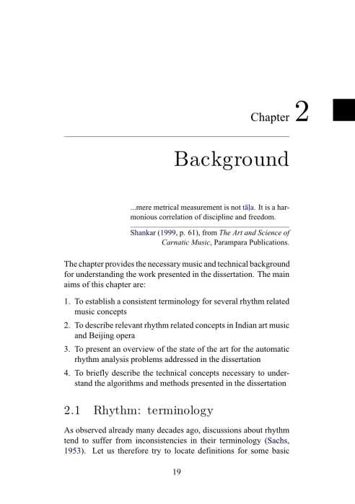
Topics
Background
Main contributions
Data corpora for rhythm analysis
Meter inference and tracking
Percussion pattern discovery
Summary
Notes:
Given this introduction, I will talk about these topics in this presentation. After a brief background, I will discuss the three main contributions of the thesis.

Slide 18
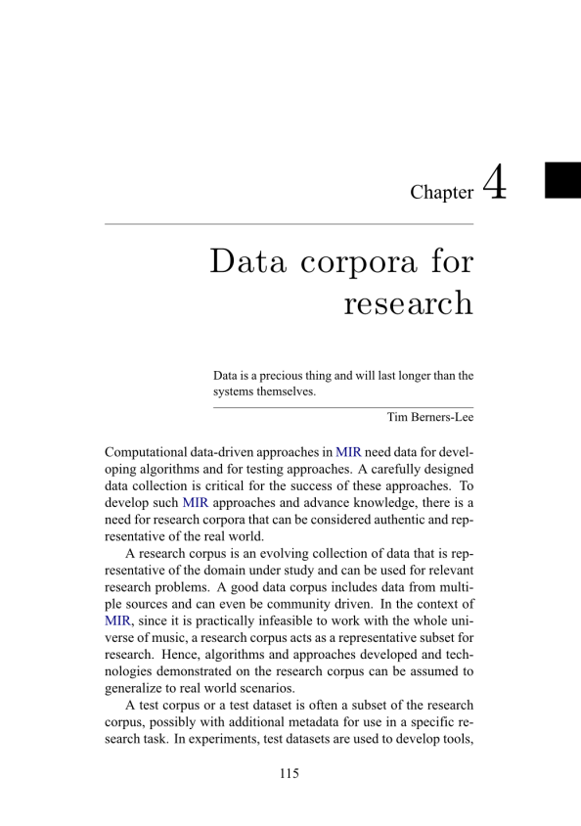
Topics
Background
Main contributions
Data corpora for rhythm analysis
Meter inference and tracking
Percussion pattern discovery
Summary
Notes:
Data corpora for rhythm related MIR

Slide 19
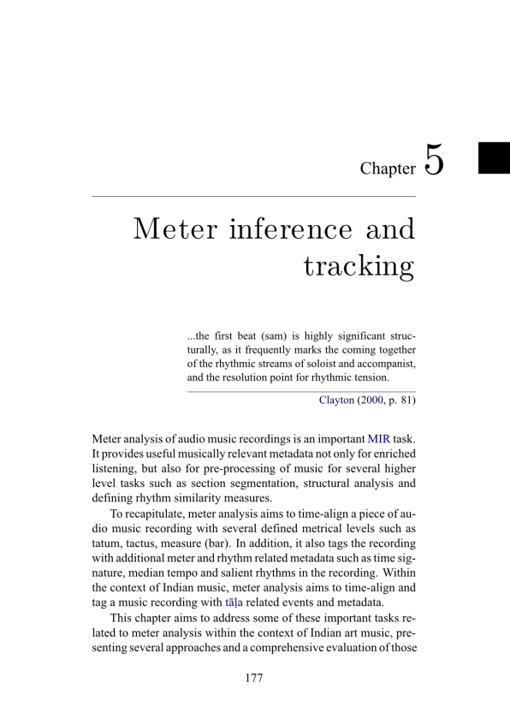
Topics
Background
Main contributions
Data corpora for rhythm analysis
Meter inference and tracking
Percussion pattern discovery
Summary
Notes:
Meter inference and tracking

Slide 20
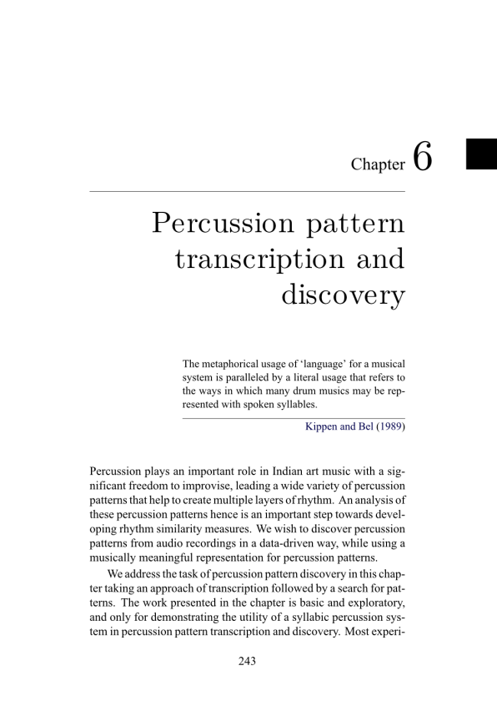
Topics
Background
Main contributions
Data corpora for rhythm analysis
Meter inference and tracking
Percussion pattern discovery
Summary
Notes:
Percussion pattern discovery

Slide 21
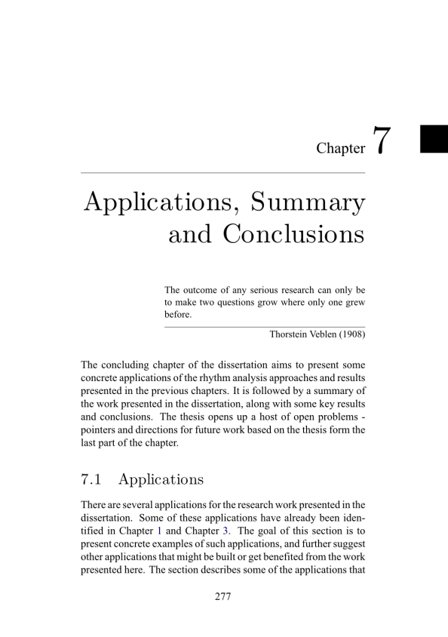
Topics
Background
Main contributions
Data corpora for rhythm analysis
Meter inference and tracking
Percussion pattern discovery
Summary
Notes:
And wrap it up with a summary. (4 min)

Slide 22
Topics – not discussed
Review of automatic rhythm analysis (Sec 2.3)
Automatic rhythm analysis problems in Indian art music (Sec 3.2)
Extensions to other music cultures
E.g. Jingju (Sec 2.2.5 and Sec 6.2)
Detailed description and analysis of data corpora (Sec 4.1)
Applications related to thesis problems (Sec 7.1)
Notes:
Given the time, there are some topics that have been discussed in the document but are not a part of this presentation – mainly a review of automatic rhythm analysis, including some problems in Indian art music that are not addressed in the thesis. Extensions to other music cultures such as Jingju (Beijing Opera). A detailed description of data corpora and applications related to the thesis problems. (5 min)

Slide 23
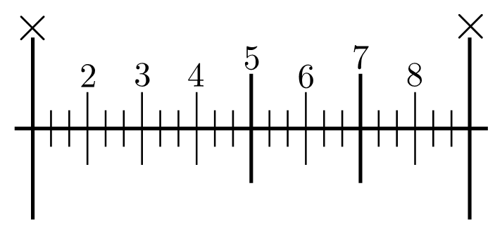
Background

Slide 24
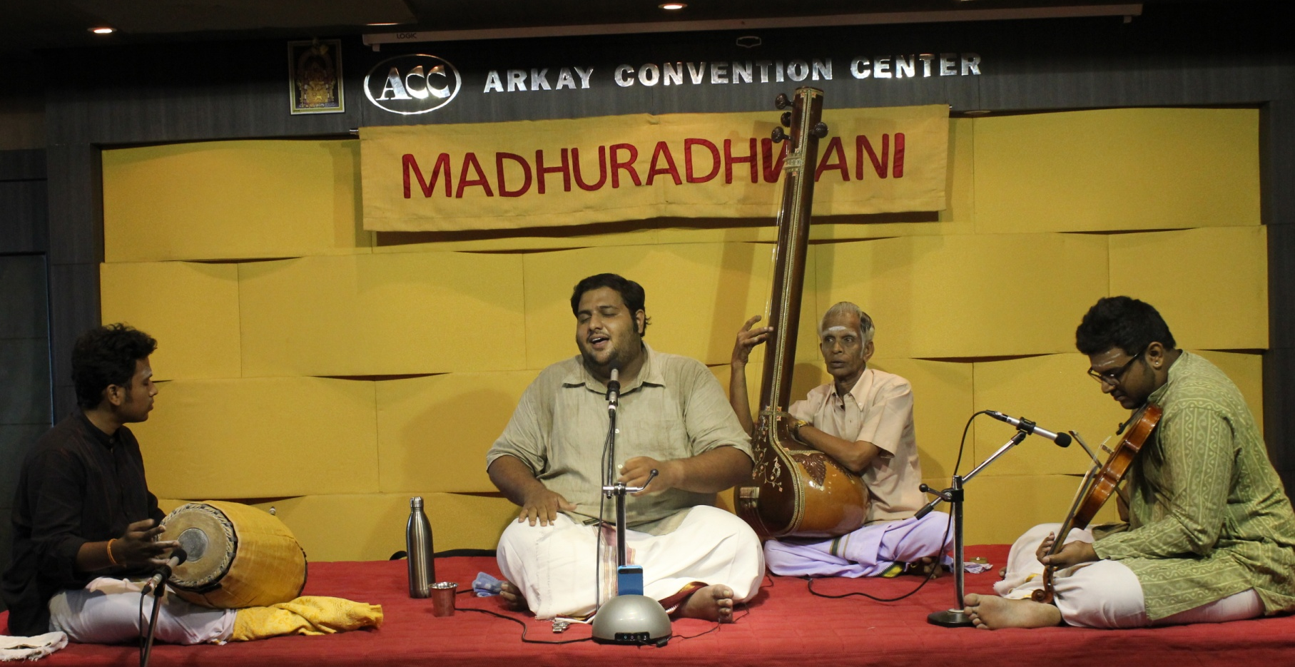
Rhythm in Carnatic music
Vignesh Ishwar in concert at Arkay Convention Center, Chennai, India
Notes:
Indian art music refers to two main music cultures – Carnatic music from Southern parts of Indian subcontinent, which we see here. The main percussion accompaniment is the mridangam, with a lead vocal and other melodic accompaniments.

Slide 25
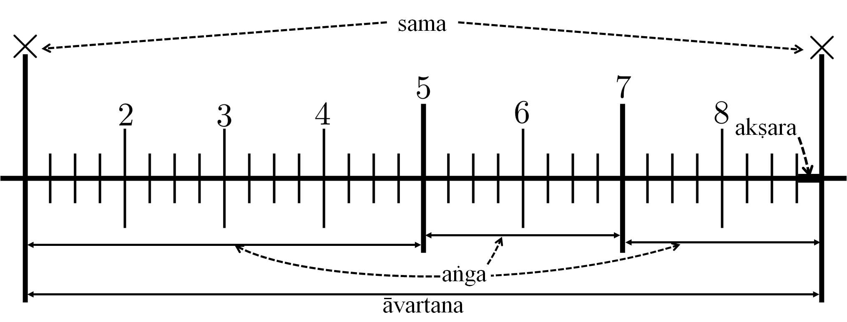
Tāla in Carnatic music
Time cycles
Broad structure for rendition and repetition of melodic and rhythmic phrases, motifs, and improvisations
Akṣara, “beats”, sama (downbeat), aṅga (section)
Sec 2.2.2
Notes:
Rhythm in CM is organized based on the concept of tala, which consists of metrical time cycles that provide a broad structure for rendition of …
One cycle is shown there, the cycle is divided into smallest time units called aksharas, which are grouped into beats, and into sections called angas, and the start of the cycle is called the sama (analogous to the downbeat).

Slide 26
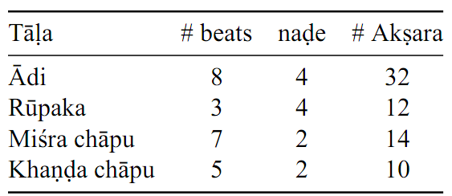
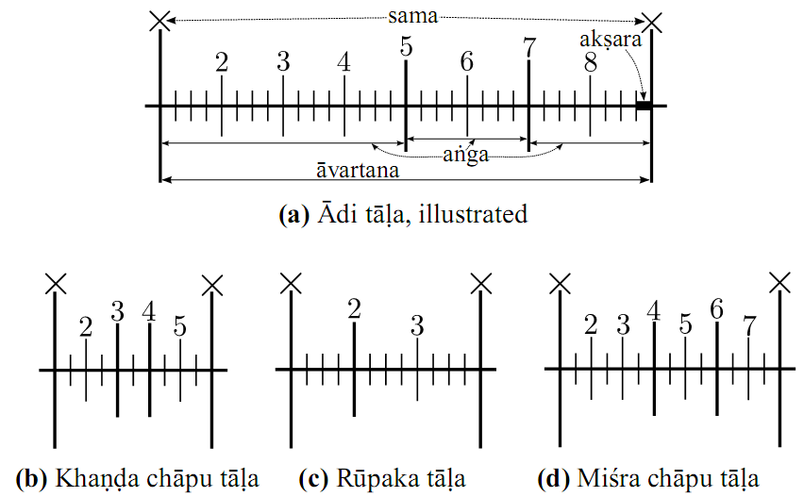
Popular tālas
Sec 2.2.2
Notes:
In the thesis, we restrict ourselves to these four different talas, which span most of music performed today. As you see they have different structures.

Slide 27
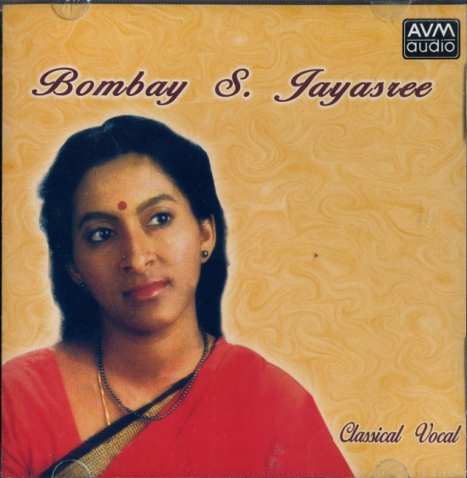
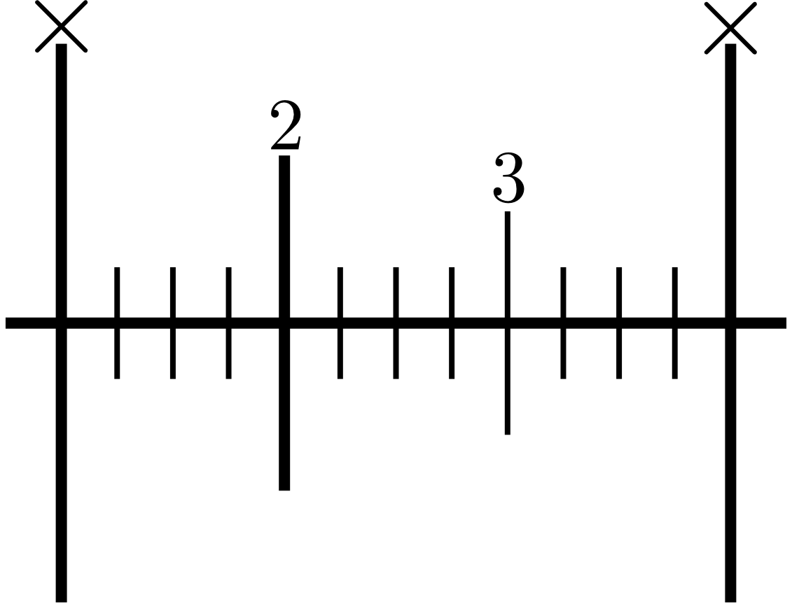

An example
Artist: Bombay Jayasree (vocal)
Release: Classical Vocal
Composition: Śaṅkari nīvē
Composer: Subbaraya Sastry
Rāga: Bēgaḍa
Tāla: Rūpaka (Cycle of 12 akṣara)
http://musicbrainz.org/recording/fe63aa10-bfa0-4dc6-9845-e57811c2feaa
Notes:
This is an example is rupaka tala, a cycle of 3 beats. The audio example has clicks to mark the sama and beats. <Play audio>. This is a short cycle, and easy to track!

Slide 28
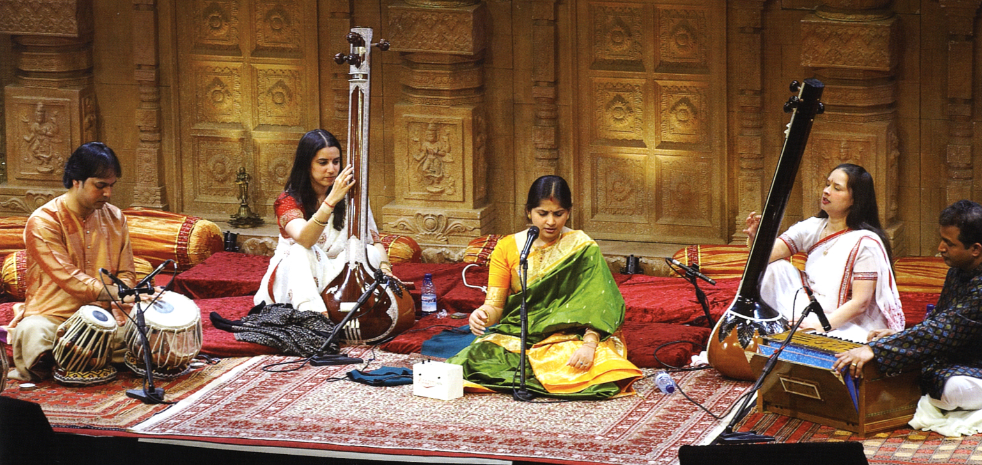
Rhythm in Hindustani music
https://musicboxnews.files.wordpress.com/2011/09/darbar-festival-20081.jpg
Notes:
Hindustani music is an art music tradition from Northern parts of the Indian subcontinent. The main percussion accompaniment here is the tabla, with lead vocals/instruments.

Slide 29
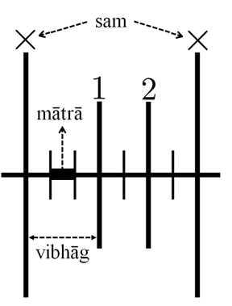
Tāl in Hindustani music
Metrical time cycles
Broad structure for rendition and repetition of melodic and rhythmic phrases, motifs, and improvisations
mātrā (beat), sam (downbeat), vibhāg (section)
Tempo classes (lay)
Wide range of tempi
Slow (vilaṁbit): 10-60 mātrā per minute (MPM)
Medium (madhya): 60-150 MPM
Fast (drut): >150 MPM
Sec 2.2.3
Notes:
Rhythm in HM is organized based on the concept of taal, which consists of metrical time cycles that provide a broad structure for rendition of …
One cycle is shown there, the cycle is divided into matras (analogous to beat), grouped into sections (vibhaags), and the start of the cycle is called the sam (analogous to the downbeat).

Slide 30
Tāl in Hindustani music
Metrical time cycles
Broad structure for rendition and repetition of melodic and rhythmic phrases, motifs, and improvisations
mātrā (beat), sam (downbeat), vibhāg (section)
Tempo classes (lay)
Wide range of tempi
Slow (vilaṁbit): 10-60 mātrā per minute (MPM)
Medium (madhya): 60-150 MPM
Fast (drut): >150 MPM
Sec 2.2.3
Notes:
One feature of HM is the wide range of tempo that means a wide variety of cycle lengths. The pieces are grouped into tempo classes – slow, medium and fast: 2s to 65 s range!

Slide 31
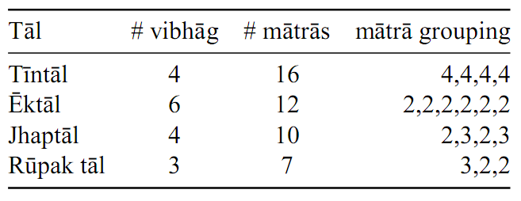
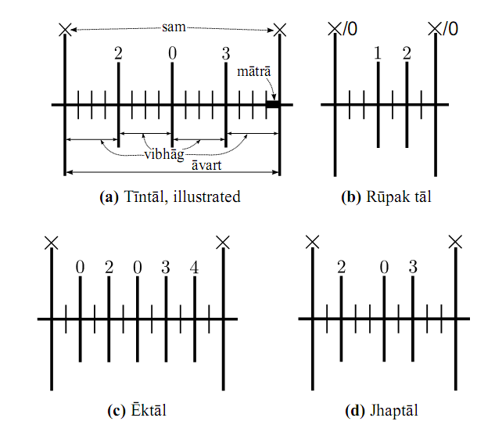
Popular tāls
Sec 2.2.3
Notes:
In the thesis, we restrict ourselves to these four taals, which span a majority of Hindustani khayal music performed today.

Slide 32
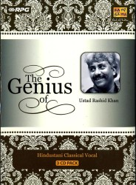
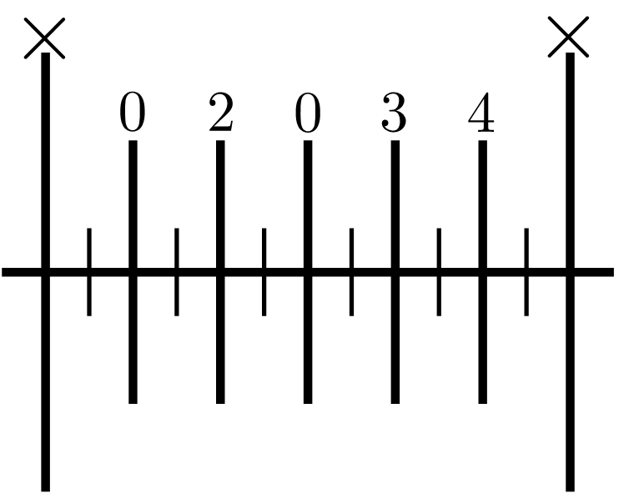
An example
Artist: Rashid Khan (vocal)
Release: The Genius Of Ustad Rashid Khan
Composition: Rasiya Maara Ama Laara
Rāga: Ahir Bhairav
Tāla: Ektāl (Cycle of 12 mātrās)
https://musicbrainz.org/recording/def59da7-8d7b-4047-b16c-eeee65482e87
Notes:
Here is an example of vilambit (slow) ektal, a cycle of 12 matras. Let try and track the progression through the cycle. It has clicks to mark the matras, and I will show you the sam (downbeat). Play audio, stop after 3 beats. – Where are we ? It’s a slow piece, we can come back and listen to this later!

Slide 33
Some observations
Phrasal, melodic and rhythmic changes closely tied to tāl/a
State of the art – concepts do not extend
E.g. Possibly non-isochronous beats/sections
Underlying rhythmic structures
Not explicit in the signal
Musical definitions → Engineering formulations
A. Srinivasamurthy, A. Holzapfel, and X. Serra (2014). In Search of Automatic Rhythm Analysis
Methods for Turkish and Indian Art Music. Journal of New Music Research, 43(1):97–117.
Sec 2.2.4
Notes:
Some observations from the examples we just heard. The phrasal, melodic and rhythmic changes were closely tied to the tala. The state of the art definitions do not directly extend here e.g. there are non-isochronous sections. The underlying rhythmic structures are not explicit in signal or in the surface rhythm, and there is a need to convert these musical definitions in engineering formulations. With that, we look at another important aspect related to percussion, which is…

Slide 34
Syllabic percussion systems
Mnemonics for oral transmission – syllables
Possibly onomatopoeic
Define and describe percussion patterns
Also an important role in many aspects of rhythm
A language for percussion
Clear analogy to speech
Musically meaningful representation
Subtleties of articulation, timbre and dynamics
Vocal percussion – art form
Clayton, Martin (2000). Time in Indian music : rhythm, metre and form in North Indian rag performance, p. 58, Oxford University Press.
Keçecioğlu, M. U. (2010). Usul-Velvele Editor. http://notist.org/usul_velvele%20editor_ing.html
Sec 2.2
Notes:
Syllabic percussion systems, which exist in several music cultures around the world, use mnemonics for oral transmission of repertoire. These mnemonics or syllables are possibly onomatopoeic, and can be effectively used to define and describe percussion patterns, thus providing a language for percussion. This has a very clear analogy to speech and language, while the syllables capture articulation, timbre and dynamics - which can exploited for our purposes. Vocal percussion is even a practised art form and can get quite sophisticated!

Slide 35
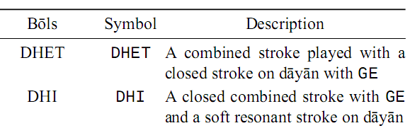
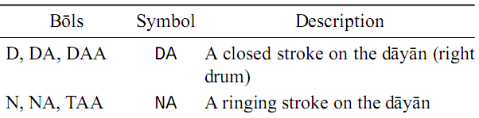
Bōl in Hindustani music
Strokes of the tabla
Timbrally grouped for automatic analysis
Sec 2.2.3
Notes:
In the context of Hindustani music, the percussion syllables are called bols, which are the strokes of the tabla.

Slide 36
Bōl in Hindustani music
Strokes of the tabla
Timbrally grouped for automatic analysis
Sec 2.2.3
Notes:
Since there is a many syllable to one timbre mapping, we group similar timbre syllable together into syllable classes for automatic analysis.

Slide 37
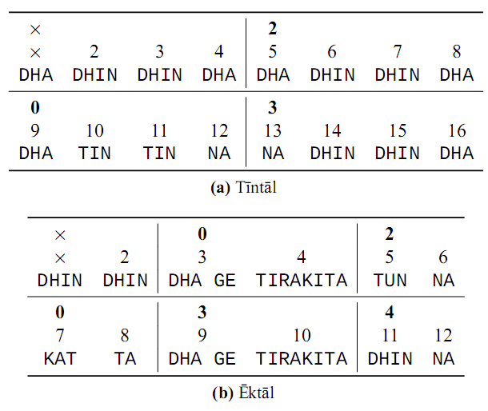
Canonical patterns of a tāl (ṭhēkā)
Sec 2.2.3
Notes:
The bols are used to define the canonical patterns of a taal, and are hence quite important. Here is an example for ektal, which we heard a while ago. <Play audio> - Of course, this is at a much faster tempo.

Slide 38
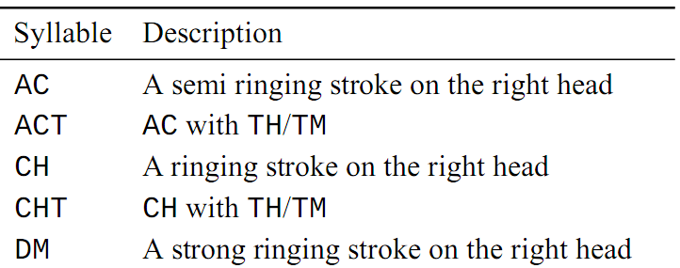
Carnatic music – Solkattu
Strokes of the mridangam
Compound strokes grouped together
Sec 2.2.2
Notes:
In Carnatic music, we have solkattu which are syllables of the mridangam and similar timbral grouping of compound strokes is done for automatic analysis.

Slide 39
Summary – Indian art music
Oral traditions, improvised
Tāla is the basic skeletal rhythmic framework
No metronome, flexible timing
Wide tempo range in HM, smaller in CM
Surface rhythm – indicators to underlying structures
Well defined syllabic percussion systems
Have unmetered forms
Beyond the scope of automatic rhythm analysis
Sec 2.2.4
Notes:
In summary, Indian art music traditions are oral traditions and improvised, with tala as the basic skeletal framework. There is no metronome, and hence flexible timing with a wide range of tempo. The surface rhythm are indicators to underlying metrical structures. They have well defined syllabic percussion systems. They also have unmetered forms, which are beyond the scope of automatic rhythm analysis methods in this thesis. (12 min)

Slide 40
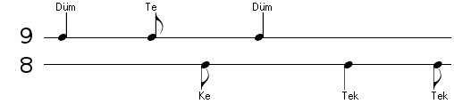
Turkish Makam music
Usul – Metrical grid
Usul described using syllables
Düm, te, tek, ke, …
Usul Aksak (9/8)
Keçecioğlu, M. U. (2010). Usul-Velvele Editor. http://notist.org/usul_velvele%20editor_ing.html

Slide 41
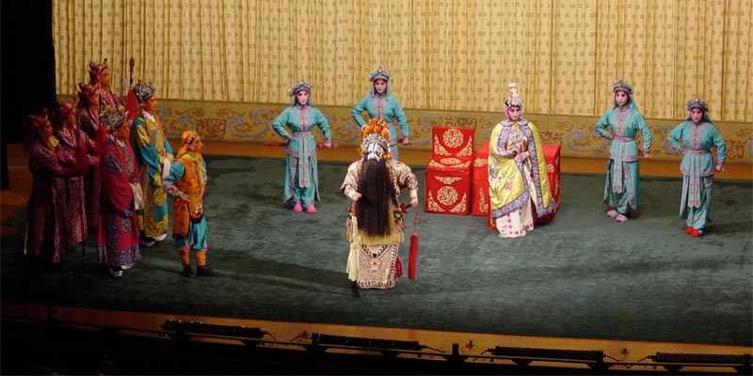
Beijing opera (Jingju)
http://upload.wikimedia.org/wikipedia/commons/6/61/BeijingOperaProduction.jpg

Slide 42
Rhythm and percussion in Beijing opera
Beijing opera – Theatre
Acting, Singing, Instrumental accompaniment
Percussion ensemble – pivotal role
Maintain rhythmicity
Percussion patterns
Well defined syllabic system
Fixed limited set of percussion patterns
Notes:
Tutorial, papers, concert

Slide 43
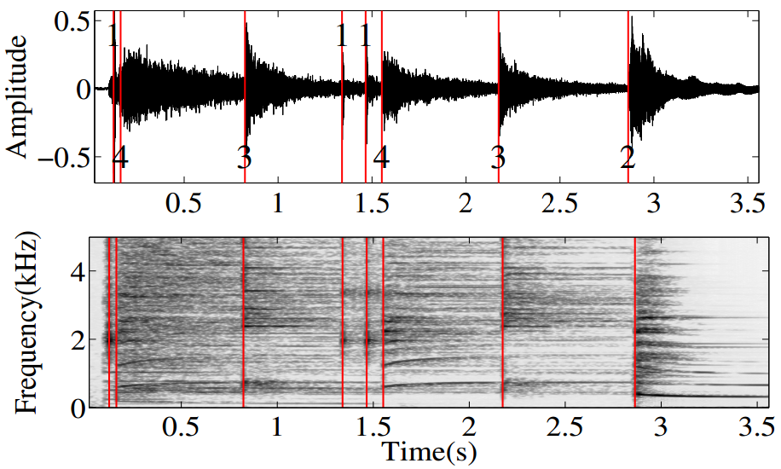
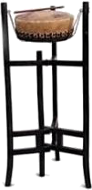
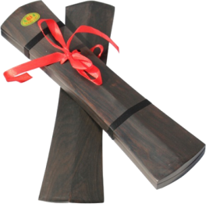
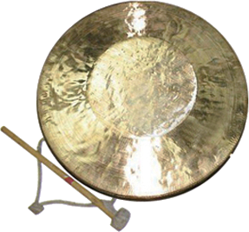
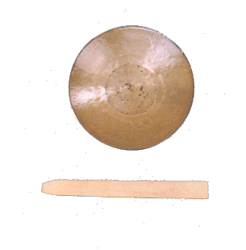
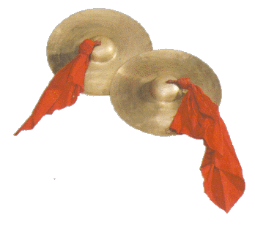
Percussion instruments
Ban + danpigu (Bangu)
Clapper Drum (1)
Daluo
Large gong (2)
Naobo
Cymbals (3)
Xiaoluo
Small Gong (4)

Slide 44
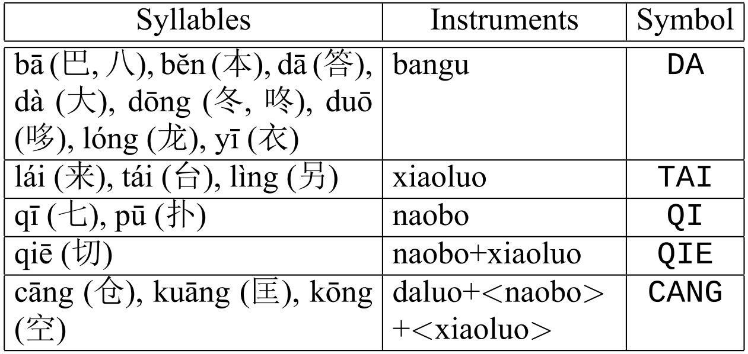
Percussion syllables
Ensemble – Combination of strokes
Combined timbre of the ensemble

Slide 45

Percussion patterns
Sequence of strokes by combinations of instruments – learnt and played as a sequence of syllables
Mark important structural points in an aria
Limited in number, labeled, well defined
Classification of patterns useful for structural segmentation of arias
Subsequence repetitions, indicative score, variations
Score for the pattern shanchui (indicative)
Notes:
1 0 1 0 0 0 1 1 1 1 2 1 1 1 2 0
ta - ka - - - ta ri ki ta ta ka dhi mi ta -

Slide 46
Rhythm in MIR
Onset Detection
Tempo Estimation/Tracking
Beat Tracking
Downbeat Tracking
Meter Tracking
Evaluation Measures
Rhythm Similarity Measures

Slide 47

Bayesian models
Dynamic Bayesian Networks (DBN)
Variables related over time-steps
Suitable for modeling time-sequences
HMM, Kalman filters – special cases of DBNs

Slide 48






Automatic rhythm analysis problems
Notes:
Without much detail, I just want to brief through some automatic rhythm analysis problems

Slide 49
Challenges
No scores, oral traditions
Inconsistency in definitions
Tāla: basic skeletal framework – improvisation
Subjective – same piece, two tālas
Cycles at multiple levels
Pulsation of unequal time-spans – additive meter
No absolute tempo
Wide range of tempo
Sec 3.1.1
Notes:
Optionally can be hidden!

Slide 50
Opportunities
Cyclic metrical structures – extend to many music cultures
Sophisticated rhythmic framework
Syllabic percussion systems
Musically meaningful representation for patterns
Sec 3.1.2
Notes:
Optionally can be hidden!

Slide 51

Characteristics of Indian Art Music
Sec 3.1.3

Slide 52

Automatic rhythm analysis in Indian art music
Fig 3.2
Notes:
There are several automatic rhythm analysis tasks that can be investigated in Indian art music, but . . .

Slide 53
Different problems
Building data corpora
Automatic rhythm annotation
Rhythm and percussion pattern analysis
Rhythm based audio segmentation
Ontologies for rhythm concepts
Rhythm similarity measures
Symbolic music analysis
Evaluation and Integration
Extensions to other music cultures
Sec 3.2

Slide 54
Automatic rhythm analysis in Indian art music
Fig 3.2
Notes:
We focus only on the thesis problems in the presentation, which are

Slide 55
Thesis problems
Building data corpora for automatic rhythm analysis
Meter inference and tracking
Percussion pattern transcription and discovery
Sec 3.3
Notes:
These three problems – we address each of them in detail now. (11 min)

Slide 56


Onset detection
Many sources
Different spectral characteristics
Notes:
Spectral changes

Slide 57
Onset detection
Mridangam stroke onsets
Right and Left

Slide 58


Onset detection
Temporal and spectral features
Band-wise spectral flux
Spectral magnitude change
J. Bello et al., A Tutorial on Onset Detection in Music Signals,
IEEE Transactions on Speech and Audio Processing, 13(5), 2005

Slide 59


Instrument-wise onset detection
Percussion instruments
Bases for each instrument
Non-negative matrix factorization for decomposition
http://compmusic.upf.edu/bo-perc-dataset
M. Tian, A. Srinivasamurthy, M. Sandler, and X. Serra. "A Study of Instrument-wise Onset Detection in Beijing Opera Percussion Ensembles". IEEE International Conference on Acoustics, Speech, and Signal Processing (ICASSP), 2014.
Notes:
Dataset description
[DEMO] NMF based instrument onset ID

Slide 60
Tāla recognition
Notes:
Tala recognition – supervised, multiple levels,

Slide 61
Rhythm based structural segmentation: Concert
A part of a concert
Kriti
Tani āvartanam
Padi Sarala and Hema A Murthy, “Inter and intra segmentation of Carnatic music recordings for archival,” in Proc. ISMIR 2013, Brazil.

Slide 62
Structural segmentation: Kriti
Pallavi, Anupallavi, Charanam, Swaram, Niraval

Slide 63









Data corpora for research

Slide 64
Data corpora for research
“Real World”
Research Corpus
Test
Datasets
Serra, X. (2014, January). Creating Research Corpora for the Computational Study of Music: the case of the CompMusic Project. In Proceedings of the 53rd AES International Conference on Semantic Audio. London.
Chap 4
Notes:
Set approach to describing corpora
Set withing set, the fact that it can evolve over time, adding many sources, et al
Criteria to build a corpus

Slide 65
Data corpora for research
“Real World”
Research Corpus
Test
datasets
Serra, X. (2014, January). Creating Research Corpora for the Computational Study of Music: the case of the CompMusic Project. In Proceedings of the 53rd AES International Conference on Semantic Audio. London.
Chap 4
Notes:
For data-driven research, we need a research corpus of data that is representative of the real world. For building and evaluating specific research tasks however, we build test datasets that are for most part belong to the research corpus, but can have additional data from other sources or even synthetic examples!

Slide 66
Data corpora for research
“Real World”
Research Corpus
Chap 4
Notes:
Set approach to describing corpora
Set withing set, the fact that it can evolve over time, adding many sources, et al
Criteria to build a corpus

Slide 67
Test datasets
“Real World”
Research Corpus
Test
datasets
Chap 4
Notes:
Set approach to describing corpora
Set withing set, the fact that it can evolve over time, adding many sources, et al
Criteria to build a corpus

Slide 68
Test datasets
“Real World”
Research Corpus
Test
datasets
Chap 4
Notes:
Set approach to describing corpora
Set withing set, the fact that it can evolve over time, adding many sources, et al
Criteria to build a corpus

Slide 69
Building research corpora
Building research corpora and test datasets
A research problem in itself !
Systematic approach to building MIR corpora
Criteria: Purpose, Coverage, Completeness, Quality and Reusability [Serra, 2014]
Based on reliable references
Corpora for Indian art music
An analysis of the corpus
Test datasets useful for different MIR tasks
Srinivasamurthy, A., Koduri, G. K., Gulati, S., Ishwar, V., & Serra, X. (2014, September). Corpora for Music Information Research in Indian Art Music. In Proceedings of Joint 42nd International ComputerMusic Conference/13th Sound and Music Computing Conference (pp. 1029–1036).
Sec 4.1
Notes:
Building a research corpus itself is a research problem and a systematic approach to evaluate a corpus was presented in one of our papers. In this presentation however, I will focus only on the test datasets that we use in different MIR rhythm tasks.

Slide 70

Carnatic Music Corpus

Slide 71

Carnatic corpus: Considerations
Concert – unit of music distribution
Predominantly vocal
Main reference: Madras Music Academy
Commercial releases, mainly from Charsur
Editorial metadata on MusicBrainz
Metadata references
Kutcheris.com, raaga.com
Sec 4.1.2
Notes:
Commercial audio,

Slide 72





Carnatic corpus: Content
Recording: audio, annotated and derived features
Metadata: artists, raga, tala, composer, …
Community: Forums and discussion
(rasikas.org)
Lyrics and scores
Ontology of the music concepts
Contextual Information
Sec 4.1.2

Slide 73


Coverage and Completeness
248 releases, 1650 recordings, 346 hours
Incomplete
metadata!!!
Sec 4.1.2

Slide 74

Hindustani Music Corpus

Slide 75


Hindustani corpus: Considerations
Vocal + Instrumental: Diverse
Khyal and Dhrupad forms
Primary References
ITC Sangeet Research Academy
Sangeet Natak Academi, All India Radio
Metadata reference: Swarganga
Commercial releases for audio
Metadata on MusicBrainz
Sec 4.1.3

Slide 76




Hindustani corpus: Content
Recording: audio, annotated and derived features
Metadata: artists, rag, tal, composer, …
Lyrics and scores
http://en.wikipedia.org/wiki/
Category:Hindustani_music
Contextual Information
Sec 4.1.3

Slide 77


Coverage and Completeness
~233 releases, 1096 recordings, 300 hours
Diverse!
Sec 4.1.3

Slide 78
Creative Commons music collections
Carnatic
20 concerts, 197 tracks, 40 hours
Hindustani
36 albums, 108 tracks, 43 hours
Sec 4.1.4

Slide 79
Datasets for rhythm analysis
Carnatic music rhythm dataset (CMR dataset)
Hindustani music rhythm dataset (HMR dataset)
Mulgaonkar Tabla Solo dataset (MTS dataset)
UKS Mridangam Solo dataset (UMS dataset)
Rhythm annotated datasets
Sec 4.2
Notes:
The datasets are mainly of two types. The rhythm annotated datasets . . .

Slide 80
Datasets for rhythm analysis
Carnatic music rhythm dataset (CMR dataset)
Hindustani music rhythm dataset (HMR dataset)
Mulgaonkar Tabla Solo dataset (MTS dataset)
UKS Mridangam Solo dataset (UMS dataset)
Datasets for percussion analysis
Sec 4.2
Notes:
And datasets useful for percussion analysis

Slide 81
Datasets for rhythm analysis
Carnatic music rhythm dataset (CMR dataset)
Hindustani music rhythm dataset (HMR dataset)
Mulgaonkar Tabla Solo dataset (MTS dataset)
UKS Mridangam Solo dataset (UMS dataset)
Annotations are public. Audio is commercially available and easily accessible.
Sec 4.2
Notes:
Annotations of all these datasets are public, while audio is easily accessible and well catalogued.

Slide 82
Corpus level analysis
Tempo range and distribution
Analysis of cycle length rhythm patterns
Intra-cycle tempo variations
Srinivasamurthy, A., Holzapfel, A., Ganguli, K. K., & Serra, X. Computational Rhythm analysis of a Hindustani Music Corpus (under preparation)
Sec 4.2.2
Notes:
In addition to describing datasets, we also want to do a corpus level rhythm analysis of the rhythm annotated datasets – seeking some insights from tempo, cycle length rhythm patterns and intra-cycle tempo variations. We will look only at some very key results in this presentation. Let’s begin by describing the datasets.

Slide 83

Carnatic music rhythm dataset
CMR_{f}
Srinivasamurthy, A., & Serra, X. (2014, May). A Supervised Approach to Hierarchical Metrical Cycle Tracking from Audio Music Recordings. In Proc. of the 39th IEEE International Conference on Acoustics, Speech and Signal Processing (ICASSP 2014) (pp. 5237–5241). Florence, Italy.
Sec 4.2.1
Notes:
The Carnatic music rhythm dataset consists of 16 hours of music pieces with beat and sama annotations.

Slide 84

Carnatic music rhythm dataset
CMR_{f}
CMR
Two minute excerpts
http://compmusic.upf.edu/carnatic-rhythm-dataset
Sec 4.2.1
Notes:
While a smaller 4 hour subset is also available and used for all experiments.

Slide 85
Carnatic music rhythm dataset
CMR_{f}
CMR
Sec 4.2.1
Notes:
There are over 120,000 beat annotations in the larger dataset, while about 28000 annotations are retained in CMR dataset.

Slide 86


Carnatic music rhythm dataset – tempo
CMR_{f}
CMR
Sec 4.2.1
Notes:
The table here shows the tempo ranges in the dataset, where we see CMRf and CMR have very similar characteristics.

Slide 87
Carnatic music rhythm dataset – tempo
CMR_{f}
CMR
Sec 4.2.1
Notes:
The cycle lengths, shown in the last column, are shorter in Carnatic music ranging from one second to about 7 seconds.

Slide 88
Carnatic music rhythm dataset – tempo
CMR_{f}
CMR
Sec 4.2.1
Notes:
Interesting to note is the extremely small range of the akshara period in all the talas!

Slide 89


Carnatic tempo distribution – ISI
Sec 4.2.1

Slide 90
Carnatic tempo distribution – ISI
Sec 4.2.1

Slide 91


Carnatic tempo distribution – IBI
Sec 4.2.1

Slide 92
Carnatic tempo distribution – IBI
Sec 4.2.1
Notes:
These figures show the inter beat interval histograms for all talas. The figure on the right shows a IBI normalized by the median IBI for the piece. We see that there I about 20% variation from the median tempo in pieces.

Slide 93


Hindustani music rhythm dataset
HMR_{f} dataset, two minute excerpts from full pieces
Srinivasamurthy, A., Holzapfel, A., Cemgil, A. T., & Serra, X. (2016, March). A generalized Bayesian model for tracking long metrical cycles in acoustic music signals. In Proceedings of the 41st IEEE International Conference on Acoustics, Speech and Signal Processing (ICASSP 2016) (pp. 76–80). Shanghai, China.
Sec 4.2.2
Notes:
Hindustani music, we compiled a similar dataset with 151 pieces and 5 hours of music with two min excerpts.

Slide 94
Hindustani music rhythm dataset
HMR_{f} dataset
http://compmusic.upf.edu/hindustani-rhythm-dataset
Sec 4.2.2
Notes:
Due to large range of tempo, we split this dataset into two subsets, …

Slide 95


Long cycle (duration) subset
HMR_{l} dataset (< 60 MPM, vilaṁbit)
Sec 4.2.2
Notes:
The long cycle subset with 59 slow pieces

Slide 96


Short cycle (duration) subset
HMR_{s} dataset (> 60 MPM, madhya and drut)
Sec 4.2.2
Notes:
And short cycle subset with 92 pieces.

Slide 97


HMR_{l} tempo distribution – ISI
Sec 4.2.2

Slide 98
HMR_{l} tempo distribution – ISI
Sec 4.2.2

Slide 99


HMR_{l} tempo distribution – IBI
Sec 4.2.2

Slide 100
HMR_{l} tempo distribution – IBI
Sec 4.2.2
Notes:
We can see the tempo distributions of the subsets separately, similar to Carnatic music, which shows a much smaller deviation from median tempo (about 10%) that CM.

Slide 101


HMR_{s} tempo distribution – ISI
Sec 4.2.2

Slide 102
HMR_{s} tempo distribution – ISI
Sec 4.2.2

Slide 103


HMR_{s} tempo distribution – IBI
Sec 4.2.2

Slide 104
HMR_{s} tempo distribution – IBI
Sec 4.2.2
Notes:
A similar observation can be made with the short cycle subset as well.

Slide 105


Intra-cycle tempo variation
HMR_{l} dataset
HMR_{s} dataset
Srinivasamurthy, A., Holzapfel, A., Ganguli, K. K., & Serra, X. Computational Rhythm analysis of a Hindustani Music Corpus (under preparation)

Slide 106
Intra-cycle tempo variation
HMR_{l} dataset
HMR_{s} dataset
Srinivasamurthy, A., Holzapfel, A., Ganguli, K. K., & Serra, X. Computational Rhythm analysis of a Hindustani Music Corpus (under preparation)

Slide 107
Corpus level analysis
Tempo range and distribution
Analysis of cycle length rhythm patterns
Intra-cycle tempo variations
Srinivasamurthy, A., Holzapfel, A., Ganguli, K. K., & Serra, X. Computational Rhythm analysis of a Hindustani Music Corpus (under preparation)
Sec 4.2.2
Notes:
In addition to describing datasets, we also want to do a corpus level rhythm analysis of the rhythm annotated datasets – seeking some insights from tempo, cycle length rhythm patterns and intra-cycle tempo variations. We will look only at some very key results in this presentation. Let’s begin by describing the datasets.

Slide 108
Cycle length rhythm patterns
Musically relevant
Useful for meter analysis
Spectral flux feature
Indicative of onsets
Average patterns
Over the complete dataset
Sec 4.2.1
Notes:
Finally, we now look at some key results from cycle length rhythm pattern analysis. Cycle length rhythm patterns are musically relevant useful for meter analysis.

Slide 109

Cycle length rhythm patterns
Musically relevant
Useful for meter analysis
Spectral flux feature
Indicative of onsets
Average patterns
Over the complete dataset
Holzapfel, A., Krebs, F., & Srinivasamurthy, A. (2014, October). Tracking the "odd": Meter inference in a culturally diverse music corpus. In Proc. of the 15th International Society forMusic Information Retrieval Conference (ISMIR 2014) (pp. 425–430). Taipei, Taiwan.
Sec 4.2.1
Notes:
To plot them, we compute a spectral flux feature from the audio signal in two different frequency bands, which are indicative of onsets in the music pieces.

Slide 110
Cycle length rhythm patterns
Musically relevant
Useful for meter analysis
Spectral flux feature
Indicative of onsets
Average patterns
Over the complete dataset
Sec 4.2.1
Notes:
We then compute an average of all the cycle length patterns of a tala in a dataset.

Slide 111




Rhythm patterns in CMR_{f} dataset
Averaged over entire CMR_{f} dataset, for each tāla
Sec 4.2.1
Notes:
This is an example of such rhythm patterns – averaged over CMRf dataset for four talas. It shows the average spectral flux value at each metrical position, with X marking the sama.

Slide 112
Rhythm patterns in CMR_{f} dataset
Averaged over entire CMR_{f} dataset, for each tāla
Low frequency band, left bass strokes of mridangam
Sec 4.2.1
Notes:
The lower panel from low frequency band is indicative of bass content, …

Slide 113
Rhythm patterns in CMR_{f} dataset
Averaged over entire CMR_{f} dataset, for each tāla
High frequency band, right strokes of mridangam
Sec 4.2.1
Notes:
while the upper panel has the rest of the content, mainly from the right strokes of mridangam.

Slide 114
Rhythm patterns in CMR_{f} dataset
Stronger accents on akṣaras, beats and sama
Some positions have stronger accents
Sec 4.2.1
Notes:
Key observations here is that there are stronger accents on akshara, beats and sama positions, …

Slide 115
Rhythm patterns in CMR_{f} dataset
Stronger accents on akṣaras and beats
Some positions have stronger accents
Sec 4.2.1
Notes:
While some talas have stronger accents at specific positions (mostly section boundaries) depending on the tala, e.g. adi tala has it on the section boundaries.

Slide 116




Rhythm patterns in HMR_{l} dataset
Rhythm patterns on long and short cycle subsets
Sec 4.2.2
Notes:
Rhythm patterns for Hindustani music are plotted on the two subsets separately.

Slide 117
Rhythm patterns in HMR_{l} dataset
Low frequency band, left bass strokes of the tabla
Sec 4.2.2
Notes:
Rhythm patterns for Hindustani music are plotted on the two subsets separately.

Slide 118
Rhythm patterns in HMR_{l} dataset
High frequency band, right strokes of tabla
Sec 4.2.2
Notes:
Rhythm patterns for Hindustani music are plotted on the two subsets separately.

Slide 119
Rhythm patterns in HMR_{l} dataset
Stronger accents on the mātrā – mātrās are anchors
Fillers between mātrās – vilaṁbit
Sec 4.2.2
Notes:
In long cycle subset, the accents are on matras which act as anchors in vilambit pieces, while we see filler strokes between matras. There are many interesting observations from these figures, e.g.

Slide 120
Rhythm patterns in HMR_{l} dataset
Tīntāl – 14th mātra strong left accent
Indicating the arrival of sam (āmad)
Sec 4.2.2
Notes:
e.g. Tintal shows strong accents towards the end of cycle, which indicates the arrival of sam, very characteristic of Hindustani music.

Slide 121
Rhythm patterns in HMR_{l} dataset
Ektāl – TI RA KI TA mātrās (4 and 10) are more dense
More fillers since the cycle is longer
Sec 4.2.2

Slide 122
Rhythm patterns in HMR_{l} dataset
Jhaptāl – mātrās 2 and 7 have fillers to anchor the cycle
Sec 4.2.2

Slide 123
Rhythm patterns in HMR_{l} dataset
Rūpak tāl – sam is unaccented, but often a left stroke is played
Strong accent on mātrā 2 – indicates a 1 + 2 + 2 + 2 structure
Sec 4.2.2

Slide 124




Rhythm patterns in HMR_{s} dataset
Less fillers, shorter cycles
Vibhāg are anchors
Sec 4.2.2
Notes:
In the short cycle subset, we see less fillers and sections now act as anchors since cycles are short. There are also several interesting observations here, e.g.

Slide 125
Rhythm patterns in HMR_{s} dataset
Tīntāl – start of last vibhāg, more fillers
Indication of sam coming up
Sec 4.2.2
Notes:
Indicating the arrival of sam is back in tintal, even in short cycle subset. That was a glimpse of the several more observations we have in the document, which shows how interesting these rhythm patterns are for performance analysis in musicology.

Slide 126
Rhythm patterns in HMR_{s} dataset
Ektāl – short cycles, taking up a triple meter
TI RA KI TA in mātrās 4 and 10 – two strokes
Sec 4.2.2

Slide 127
Rhythm patterns in HMR_{s} dataset
Jhaptāl – Vibhāg 2 and 4 are identical in theory
Sec 4.2.2

Slide 128
Rhythm patterns in HMR_{s} dataset
Rūpak tāl – goes back to 3 + 2 + 2 structure
Sec 4.2.2

Slide 129

Mulgaonkar Tabla Solo (MTS) dataset
8245 syllables, 38 compositions, tīntāl, 17 min, time-aligned
http://compmusic.upf.edu/tabla-solo-dataset
Gupta, S., Srinivasamurthy, A., Kumar, M., Murthy, H., & Serra, X. (2015, October). Discovery of Syllabic Percussion Patterns in Tabla Solo Recordings. In Proceedings of the 16th International Society for Music Information Retrieval Conference (ISMIR 2015) (pp. 385–391). Malaga, Spain.
Sec 4.2.3
Notes:
Finally, the percussion solo dataset of tabla has about 17 minutes of audio with over 8200 syllables spanning 38 solo compositions in tintal, with time aligned syllabic transcriptions from these 18 mapped syllable groups.

Slide 130

UKS Mridangam Solo (UMS) dataset
8877 syllables, 24 min, ādi and rūpaka tāla, not time-aligned
http://compmusic.upf.edu/mridangam-tani-dataset
Kuriakose, J., Kumar, J. C., Sarala, P., Murthy, H. A., Sivaraman,U.K. (2015, February). Akshara Transcription of Mrudangam Strokes in CarnaticMusic. In Proc. 21st National Conference on Communication. Mumbai, India.
Sec 4.2.4
Notes:
The mridangam solo dataset on the other hand has 24 min of audio with 8800 syllables, from two talas, but non-time aligned transcriptions. The dataset was prepared by IITM in India, and they have now added time-aligned transcriptions recently, which is useful.

Slide 131
Ballroom dataset
Several dance styles from BallroomDancers.com
697 thirty second clips
Beat and downbeat annotated
Time signatures 3/4 and 4/4
fixed through the piece
Gouyon, F., Klapuri, A., Dixon, S., Alonso, M., Tzanetakis, G., Uhle, C., & Cano, P. (2006). An experimental comparison of audio tempo induction algorithms. IEEE Transactions on Audio, Speech and Language Processing, 14(5), 1832–1844
Sec 4.2.7
Notes:
Finally, the ballroom dataset is used for evaluating some of our meter analysis algorithms in the thesis, since it has been used in many recent evaluations. It has about 700 clips spanning several dance styles and two different time signatures. (18 min)

Slide 132

Meter inference and tracking
Notes:
We now move to the second topic of thesis – meter inference and tracking

Slide 133
Meter analysis
Analysis of different aspects of meter
Events such as beats, downbeats
Tempo, rhythm class (tāl/a), patterns
Sec 5.1
Notes:
Meter analysis refers to estimating different aspects of meter such as beats, downbeats, tempo, rhythm class, and rhythm patterns . . .

Slide 134
Meter analysis
Analysis of different aspects of meter
Events such as beats, downbeats
Tempo, rhythm class (tāl/a), patterns
Enriched listening, further rhythmic and structural analysis
Rhythm similarity measures
Sec 5.1
Notes:
with applications as discussed before in enriched listening and further higher level structural analysis and defining rhythm similarity measures.

Slide 135

The goal !
Notes:
The goal is to align different levels of metrical events given an audio recording, this figure shows the relevant non-isochronous sections of khanda chapu tala.

Slide 136
Meter analysis tasks
Meter inference
Rhythm class + tempo + beats + downbeats
Meter tracking
Rhythm class/metrical structure known
Tempo + beats + downbeats
Informed meter tracking
Tempo informed meter tracking – tight tempo range known/given
Tempo + downbeat (sama) informed meter tracking
A tight tempo range known
A few downbeat instances known/given
Sec 5.1
Notes:
With the goal of infusing different levels of music knowledge into the task, we define different meter analysis tasks. Meter inference, which is the most uninformed has no prior information.

Slide 137
Meter analysis tasks
Meter inference
Rhythm class + tempo + beats + downbeats
Meter tracking
Rhythm class/metrical structure known
Tempo + beats + downbeats
Informed meter tracking
Tempo informed meter tracking – tight tempo range known/given
Tempo + downbeat (sama) informed meter tracking
A tight tempo range known
A few downbeat instances known/given
Sec 5.1
Notes:
Meter tracking is when we know the tala or rhythm class and we estimate the tempo, beats and downbeats. This is a fair assumption since tala is a part of editorial metadata in most recordings.

Slide 138
Meter analysis tasks
Meter inference
Rhythm class + tempo + beats + downbeats
Meter tracking
Rhythm class/metrical structure known
Tempo + beats + downbeats
Informed meter tracking
Tempo informed meter tracking – tight tempo range known/given
Tempo + downbeat (sama) informed meter tracking
A tight tempo range known
A few downbeat instances known/given
Sec 5.1
Notes:
Tempo-informed meter tracking is when we have tight range of tempo given. This assumes tempo is estimated independently.

Slide 139
Meter analysis tasks
Meter inference
Rhythm class + tempo + beats + downbeats
Meter tracking
Rhythm class/metrical structure known
Tempo + beats + downbeats
Informed meter tracking
Tempo informed meter tracking – tight tempo range known/given
Tempo + downbeat (sama) informed meter tracking
A tight tempo range known
A few downbeat instances known/given
Sec 5.1
Notes:
The most informed task is tempo-sama-informed tracking, where the tempo and a few instances of sama are given. Informed tracking has practical applications in supervised annotation, where a listener or musician marks the first few samas – from which an estimate of tempo and the beginning of cycle can be obtained and the meter tracker can track the rest of the piece.

Slide 140
State of the art
Tempo estimation
Well explored, utilizes periodicity in onsets
Beat tracking
“Foot tapping times” in a piece of music
Several approaches, but assume isochronicity
Time signature estimation
Estimating the metrical structure
Downbeat (sama) tracking
Recently addressed
Integrated approaches – recent efforts
Sec 3.2
Notes:
When we look at the state of the art in automatic meter analysis, we see that each of the tasks of tempo estimation, beat tracking, time signature estimation and recently downbeat tracking have been addressed separately.

Slide 141
State of the art
Tempo estimation
Well explored, utilizes periodicity in onsets
Beat tracking
“Foot tapping times” in a piece of music
Several approaches, but assume isochronicity
Time signature estimation
Estimating the metrical structure
Downbeat (sama) tracking
Recently addressed
Integrated approaches – recent efforts
Sec 3.2
Notes:
Only recently have we seen integrated approaches, which form the base for our approaches in the thesis.

Slide 142


Evaluation of meter analysis tasks
Equivalent definitions for beats and downbeats
Metrical ambiguity
CML and AML
Precision ( )
Recall ( )
f-measure ( )
Information Gain ( )
Continuity based measure: AML_{t}
Sec 2.3.7
Notes:
Before we proceed further, we first understand how evaluate meter analysis algorithms. The performance measures have equivalent definitions for beats and downbeats and are standard in beat tracking evaluations. Given a sequence of ground truth beats and sequence from output of a meter tracker, we compute the measures of precision, recall, and their harmonic mean called f-measure, which are standard information retrieval measures. However, to handle metrical ambiguities and allow for continuity, we also compute the measures at correct metrical levels and allowed metrical levels (which don’t penalize tempo doubling or halving). Information gain is another measure that measures how closely related are the ground truth and output, using the entropy of the error. AMLt combines AML and continuity.

Slide 143



Preliminary check – MIR state of the art
Poor, insufficient performance
Lack of engineering definitions of musical concepts
Need for methods that explicitly use the knowledge of metrical structures
“Downbeat” estimation
“Cycle length” estimation
Srinivasamurthy, A., Holzapfel, A., & Serra, X. (2014). In Search of Automatic Rhythm Analysis Methods for Turkish and Indian Art Music. Journal of New Music Research. 43(1),97–117
Sec 3.4
Notes:
We first did a preliminary check with some state of the art algorithms with some of these meter analysis tasks in Indian art music in a paper. The methods were not made for Indian music and we had to adapt the tasks, but the key take aways from the results was that the performance of state of the art was poor and insufficient, lacked engineering definitions for our concepts and needed methods that explicitly used the knowledge of metrical structures.

Slide 144

Preliminary approach – dynamic programming
Srinivasamurthy, A., & Serra, X. (2014, May). A Supervised Approach to Hierarchical Metrical Cycle Tracking from Audio Music Recordings. In Proc. of the 39th IEEE International Conference on Acoustics, Speech and Signal Processing (ICASSP 2014) (pp. 5237–5241). Florence, Italy.
Sec 5.2
Notes:
In another approach for sama and akshara tracking in Carnatic music, we used an adhoc method using a spectral flux based onset detection function to estimate candidates for akshara and sama and selected candidates from them based on a continuity based cost function in a dynamic programming approach.

Slide 145


Preliminary results
Evaluated on CMR_{f} dataset
Accurate tempo tracking
Poor sama tracking
Adhoc approach – cannot be extended or improved easily
Tempo estimation and tracking
Sama tracking
Sec 5.2
Notes:
Results from that paper showed some accurate tempo tracking, but very poor sama tracking. The adhoc nature of the approach provided for no way to further improve it, which brings us to . . .

Slide 146

Bayesian models for meter analysis
Notes:
Bayesian models for meter analysis, which can explicitly include these musical structures in their formulations. (25 min)

Slide 147
Bayesian models for meter analysis
Bayesian models for joint estimation of tempo, beats and downbeats
The bar pointer model
Bar/beat length rhythmic patterns
Often learnt from data
Limitation: Restricted to short bar/cycle durations
Problems with long metrical cycles
Sec 5.3
Notes:
Bayesian models have been applied to jointly estimate components of meter from audio, of which the bar pointer model is the current state of the art. They use bar or even beat length rhythmic patterns that are learnt from data, like the rhythm patterns we saw a while ago. They have a limitation however, is that they are so far restricted to short bar durations. They are known to have problems with long metrical cycles.

Slide 148



Bar pointer model – idea
- Position in cycle
- Instantaneous tempo
Exaggerated for
illustration
Sec 5.3.1
Notes:
The idea behind the bar pointer model is to use two variables of position in cycle and instantaneous tempo to track our progression through a cycle, or more formally . . .

Slide 149


Bar pointer model (BP-model)
Dynamic Bayesian Network (DBN)
N. Whiteley, A. T. Cemgil, and S. Godsill (2007). Sequential inference of rhythmic structure in musical audio. In Proc. of the 33rd ICASSP, vol. 4, pp. 1321–1325.
Sec 5.3.1
Notes:
Bar pointer model is a Dynamic Bayesian network, which

Slide 150






Model structure
Observed feature sequence:
Latent variable sequence:
- Initial state distribution (uniform)
- Transition model
- Observation model
F. Krebs, A. Holzapfel, A. T. Cemgil, and G. Widmer (2015). Inferring metrical structure in music using particle filters. IEEE/ACM Transactions on Audio, Speech, and Language Processing, 23(5):817–827.
Sec 5.3.1
Notes:
Factorizes based on conditional dependence relationships between latent variable sequence x and observed sequence y from an audio recording, with K frames: It has an initial state distribution, a transition model and an observation model.

Slide 151






Latent variables
State of a hypothetical bar pointer
Position in cycle:
M is the length of cycle
Rhythmic pattern indicator:
Choose the observation model corresponding to the rhythmic pattern
Instantaneous tempo:
The rate at which the bar pointer progresses
Related to the length of the cycle ( )
Sec 5.3.1
Notes:
The latent variables describe the state of a bar pointer – a position indicator phi progressing at the rate of the instantaneous tempo phi_dot. In addition, a rhythm pattern indicator choose the observation model at the bar position corresponding to one of the possibly many rhythm patterns.

Slide 152


Observation model
Spectral flux
Two frequency bands
Two component GMM
For each position and pattern
ML estimates of parameters using annotated data
State tying
1/64 note, half akṣara
Sec 5.3.1
Notes:
The observation model depends on the position and the pattern, and computed by modeling the spectral flux feature in two bands as a GMM. Since the position pointer is fine grained, and assuming not much changes over a short time, 64th notes or half aksharas are tied and only one observation model is computed, which helps us to learn from limited training data.

Slide 153

Transition model
Sec 5.3.1
Notes:
The transition model between the latent variables is shown there

Slide 154




Transition model
Cyclic position pointer
Tracking:
Sec 5.3.1
Notes:
The position pointer moves at every time slice at the rate of tempo variable, and folds at the end of the cycle. While meter inference can have patterns of different lengths since there are many cycles, for tracking, all rhythm patterns are equal in length.

Slide 155


Transition model
Allow tempo changes
Normal distribution
Within allowed range of tempo:
Sec 5.3.1
Notes:
Tempo changes are Gaussian distributed around the value of tempo in the previous frame, allowing only a small change in tempo over a short time – thus maintaining continuity. The range of the tempo variable is also fixed based on prior knowledge about the music.

Slide 156

Transition model
Cycle length patterns
Capture diversity of patterns
Learnt from data
Pattern transitions
Allow transitions only at end of cycle
Time homogeneity in pattern transitions
Sec 5.3.1
Notes:
The patterns are cycle long and multiple patterns per cycle, hence pattern transitions are allowed only at the end of the cycle. We assume time-homogeneity in pattern transitions.

Slide 157




Inference
A sequence that maximizes the posterior
can then be translated into
Sama instants
Beat instants
Instantaneous tempo track
Two inference schemes
Viterbi algorithm
Particle filters
Sec 5.3.1
Notes:
With that model structure, we can now do inference, which is the task of computing an x*(1:K) that minimizes the posterior probability P(x1:k|y1:k). With that, we can obtain the sama, beats or any other position in the cycle! We also get an instantaneous tempo track. We use two inference schemes in the thesis.

Slide 158





Hidden Markov model
Discrete state space approximation of the model
:
:
Viterbi algorithm to infer the sequence
Good performance needs a fine grid
State space size: M.N.R; Large state spaces: scaling issues
Image from F. Krebs, A. Holzapfel, A. T. Cemgil, and G. Widmer (2015). Inferring metrical structure in music using particle filters. IEEE/ACM Transactions on Audio, Speech, and Language Processing, 23(5):817–827.
Sec 5.3.1
Notes:
The first scheme discretizes the state space of the latent variables which can be seen to form an HMM over the cartesian product space, in which we can use the Viterbi algorithm to obtain the most likely sequence of states. Phi and Phi dot can be discretized, however good performance needs a fine grid and state space size increases with that, leading to scaling issues.

Slide 159
Particle filters
Sequential Monte Carlo methods
A class of approximate inference algorithms to estimate the posterior density of a state space
Overcome two main problems
Discretization of state space
Scaling issues with larger state spaces - complexity scales linearly with the number of “particles”
Additionally, can incorporate long term relationships between the variables
A. Doucet and A. M. Johansen (2009). A tutorial on particle filtering and smoothing: Fifteen years later. Handbook of Nonlinear Filtering.
Sec 5.3.1

Slide 160




Particle filters
Computing is often intractable, but can be estimated point-wise
Approximate using a weighted set of points (particles) in the state space
Sample and compute weights recursively at each time step
Auxiliary Mixture Particle Filter (AMPF)
Sec 5.3.1
Notes:
A solution is to use approximate inference schemes called particle filters, which estimate the posterior point-wise using a set of Np points in the state space along with weights, called particles. Given an initial estimate xk, the online estimator samples from xk and computes weight wk for each time slice. There is a longer derivation in the thesis document, but we use a particle filter algorithm called the Auxiliary Mixture Particle Filter, which is capable of tracking multiple hypothesis over time, a feature that is essential in meter tracking due to metrical ambiguity inherent in the task.

Slide 161
Particle filters: Quick overview
Computing is often intractable, but can be estimated point-wise
Approximate using a weighted set of points (particles) in the state space
To approximate the posterior point-wise, we need a way to obtain samples , and compute weights recursively at each time step
Sec 5.3.1

Slide 162



Sequential Importance Sampling (SIS)
Proposal distribution:
With a suitable proposal density
Sec 5.3.1

Slide 163





Sequential Importance Sampling (SIS)
We choose a proposal distribution
Weight update now is,
Once we determine particle trajectories we can select the trajectory with the highest weight as the MAP state sequence
Sec 5.3.1

Slide 164
Particle filter extensions (1)
Limitation: Degeneracy
Weight concentrated in only a few particles
Resample to replace low weight particles with high weight particles
Use particle weights
Sequential Importance Sampling/Resampling (SISR) – additional resampling steps
Systematic resampling
Sec 5.3.1

Slide 165
Particle filter extensions (2)
Challenge: Multimodal posterior distribution
Metrical ambiguities: highly multimodal posterior
Resampling tends to concentrate particles in only a single dominant mode
Compress weights before resampling
Particles with lower weight have a better chance of surviving resampling
Monotonically increasing function
Auxiliary particle filter
Sec 5.3.1

Slide 166
Particle filter extensions (3)
Mixture particle filter (MPF)
Track several hypotheses through a piece to maintain multimodality
Assign each particle to a cluster (ideally representing a mode in posterior): use a cyclic distance measure
Resampling: Only particles within each cluster interact with each other
Splitting and merging of clusters is necessary
In addition, compress weights: Auxiliary Mixture Particle Filter (AMPF) - AMPF₀
J. Vermaak, A. Doucet, and P. Pérez (2003). Maintaining multimodality through mixture tracking. In Proc. of the 9th IEEE International Conference on Computer Vision, pages 1110–1116, Nice, France.
Sec 5.3.1

Slide 167
BP-model: Novel contributions
Extended and evaluated on Indian art music
Multiple rhythm patterns evaluated
Novel extensions - both at model and inference level
Mixture Observation model (MO-model)
Section Pointer model (SP-model)
Inference extensions
Sec 5.3.1
Notes:
The BP-model is a state of the art model for meter analysis. In this thesis, the novel contributions build on it and extend it and evaluate it on Indian art music. In addition multiple rhythm patterns are evaluated. Further, extensions to the model by improving the model structure and also the inference algorithm is proposed. Let’s look at these extensions.

Slide 168



Model extensions: MO-model
Capture diversity of patterns + faster meter tracking
Mixture observation model: marginalize over all patterns
BP-model
MO-model
Srinivasamurthy, A., Holzapfel, A., Cemgil, A. T., & Serra, X.(2015, October). Particle Filters for Efficient Meter Tracking with Dynamic Bayesian Networks. In Proc. of the 16th International Society for Music Information Retrieval Conference (ISMIR 2015) (pp. 197–203). Malaga, Spain.
Sec 5.3.2
Notes:
The first model extension is the Mixture observation model. If the goal is make the inference faster but still capture the diversity of patterns, MO-model can be used. The idea is to remove the conditional dependence between position and patterns, and using a mixture model over patterns, for computing observation likelihoods.

Slide 169

Model extensions: SP-model
Section Pointer model – Generalization of BP-model
Track meaningful and shorter sections
Section length patterns
BP-model
SP-model
Srinivasamurthy, A., Holzapfel, A., Cemgil, A. T., & Serra, X. (2016, March). A generalized Bayesian model for tracking long metrical cycles in acoustic music signals. In Proceedings of the 41st IEEE International Conference on Acoustics, Speech and Signal Processing (ICASSP 2016) (pp. 76–80). Shanghai, China.
Sec 5.3.2
Notes:
An important extension is the Section Pointer Model, which is a generalization of the bar pointer model. While tracking long cycles, listeners tend to track shorter meaningful sections instead of the longer cycles. With this motivation, we can use section length patterns for tracking and formulate it as such. These sections are also meaningfully defined in Indian art music and can be used. BP-model is a special case of SP-model when we assume there is only one section in a cycle.

Slide 170




Section pointer model
Transition model
Observation model
Sec 5.3.2

Slide 171



Section pointer model: Section transitions
Sec 5.3.2

Slide 172

Simplified SP-model
With V = R, one pattern per section
Sec 5.3.2

Slide 173
Inference extensions to BP-model
End-of-bar pattern sampling (AMPF_{e})
Defer decision of sampling rhythm pattern to the end of cycle
Faster Inference
Peak Hop inference (AMPF_{p}) – up to 10x faster
Onset gated weight update (AMPF_{g})
Sec 5.3.3
Notes:
The inference extensions aim to improve inference in the BP-model. The first enhancement is the end-of-bar pattern sampling. When we have multiple patterns per rhythm class, we can decide on which pattern occurred in the current bar only at the end of the cycle, not at the beginning. So, AMPFe defers the decision of sampling a rhythm pattern to the end of a cycle. In addition, we can achieve faster inference by doing inference only at frames that contain an onset, as in the peak hop inference, or update the weights only at an onset, in onset gated weight update. Both these methods make inference faster.

Slide 174
Inference extensions to BP-model
End-of-bar pattern sampling (AMPF_{e})
Defer decision of sampling rhythm pattern to the end of cycle
Faster Inference
Peak Hop inference (AMPF_{p}) – up to 10x faster
Onset gated weight update (AMPF_{g})
Sec 5.3.3
Notes:
The inference extensions aim to improve inference in the BP-model. The first enhancement is the end-of-bar pattern sampling. When we have multiple patterns per rhythm class, we can decide on which pattern occurred in the current bar only at the end of the cycle, not at the beginning. So, AMPFe defers the decision of sampling a rhythm pattern to the end of a cycle. In addition, we can achieve faster inference by doing inference only at frames that contain an onset, as in the peak hop inference, or update the weights only at an onset, in onset gated weight update. Both these methods make inference faster.

Slide 175

Summary of models
Sec 5.4
Notes:
To summarize, this is a list of all the models we discussed so far.

Slide 176
Summary of models
Sec 5.4
Notes:
The BP model

Slide 177
Summary of models
Sec 5.4
Notes:
The mixture obs model, that can be used only for tracking

Slide 178
Summary of models
Sec 5.4
Notes:
And the inference extensions (33 min)

Slide 179
Experiments and results
Notes:
Some experiment results with these models. I will emphasize on key results, while we have the entire set of results also present for further discussion if necessary.

Slide 180
Experiments: Goals
Meter Inference, tracking and informed tracking
For both Carnatic and Hindustani music
Compare performance across models for Indian music datasets
Identify limitations of the models and challenges to meter analysis with Bayesian models
Sec 5.4
Notes:
The goals of experiments is to evaluate the tasks of meter inference, tracking and informed tracking for Indian art music, comparing performance across models for Indian music datasets and finally to identify limitations of these models and challenges to meter analysis.

Slide 181
Experimental setup (1)
Music culture known
Analysis done separately on each culture
Results reported only on CMR, HMR_{l}, HMR_{s} datasets
Hindustani music: also lay informed
f-measure, InfoGain, AML_{t} for beats, f-measure for sama/downbeats
70 ms error margin
6.25% of median IAI: margin for HMR_{l} dataset sama tracking
Tracking and inference – tempo tracking
5% margin, CML and AML
Sec 5.4.1
Notes:
Experimental setup assumes that music culture is known. We report results on the smaller CMR dataset and the two subsets of Hindustani music. In essence thus, experiments with Hindustani music are also tempo class informed. We report f-measure, infoGain and AMLt for beats, and f-measure for sama/downbeats with a 70 ms error margin except when evaluating sama tracking in long cycle hindustani pieces, where use a more liberal 6% of median matra interval. This is a research question which we still need to answer – on how we evaluate downbeat tracking on such long cycles. For tempo estimation, we use 5% margin at both correct and allowed metrical levels.

Slide 182
Experimental setup (2)
Results reported for single pattern per cycle/section case
Average performance over all pieces over three trials
Tempo range fixed for each dataset a priori
AMPF
1500 particles per rhythm pattern
Sec 5.4.1
Notes:
Also, results are reported as average performance over three trials, and we show results only for single pattern per cycle/section case. The tempo range is fixed a priori. AMPF uses 1500 particles per rhythm pattern.

Slide 183

Meter inference
Sec 5.4.2
Notes:
These are results from meter inference task. The datasets are on the left

Slide 184
Meter inference
Beat f-measure
Sec 5.4.2
Notes:
The columns show beat f-measure

Slide 185
Meter inference
Beat AML_{t}
Sec 5.4.2
Notes:
The columns show beat AMLt

Slide 186
Meter inference
Beat infoGain
Sec 5.4.2
Notes:
beat infoGain

Slide 187
Meter inference
Downbeat/sama f-measure
Sec 5.4.2
Notes:
And downbeat f-measure

Slide 188
Meter inference
Tāla classification – better on short duration cycles
Sec 5.4.2
Notes:
Some key results: We see that tala classification is better on short duration cycles.

Slide 189
Meter inference
Poor performance on Hindustani long cycle subset
Sec 5.4.2
Notes:
And poorest inference performance is on Hindustani long cycle subset

Slide 190
Meter inference
Better performance on Ballroom dataset than Indian music dataset
Sec 5.4.2
Notes:
And ballroom dataset gives the best performance compared to Indian art music.

Slide 191
Meter inference
Sama tracking poorer than beat tracking
Sec 5.4.2
Notes:
And that sama tracking is poorer than beat tracking

Slide 192

Meter tracking: BP-model
Baseline – tracking performance better than inference
HMM and AMPF equivalent performance
Sec 5.4.3
Notes:
We can set another baseline with meter tracking with BP-model here, which shows improved performance over inference. HMM and AMPF show equivalent performance and hence we use AMPF for rest of experiments.

Slide 193

Meter tracking: MO-model (AMPF_{m})
R=1, equivalent to AMPF₀
Performance equivalent to BP-model
Sec 5.4.3
Notes:
MO-model with one pattern per cycle is equivalent to BP-model and shows equivalent results too.

Slide 194

Meter tracking: SP-model (AMPF_{s})
Ballroom dataset: No musically well defined sections
Evaluation only on Indian music datasets
Sama tracking improves with SP-model
Beat tracking also improves, but to a lower extent
Sec 5.4.3
Notes:
Section pointer model is evaluated only on Indian music datasets, since Ballroom dataset has no well defined sections. Key results here being that sama tracking improves with SP model.

Slide 195

Meter tracking: Inference extensions
No significant improvement over baseline
Sec 5.4.3
Notes:
Inference extensions did not show any improvement over baseline BP-model

Slide 196

Tempo informed meter tracking
Tempo update restricted to 10% range around median tempo from ground truth
Evaluated with BP-model and SP-model on Indian art music datasets
Sec 5.4.4
Notes:
With informed tracking, both tempo-informed tracking and tempo-sama-informed tracking evaluated on Indian music datasets show successive improvements mainly in sama tracking.

Slide 197

Tempo-sama informed meter tracking
Tempo range restricted + first instance of sama known
Semi-manual annotation of large corpora
Improved performance over tempo informed tracking
Sec 5.4.4

Slide 198

Summary of results: Indian art music
Sec 5.4.5
Notes:
To summarise all these results, this table shows a summary of all these models combining results from all Indian art music datasets for baseline and model extensions.

Slide 199
Summary of results: Indian art music
Sec 5.4.5
Notes:
We see a gradual improvement in both beat and sama tracking as we use different proposed models and infuse additional information into the models.

Slide 200

Statistical significance tests
Paired sample t-test at 5% significance level
Average performance over Indian music datasets
Sec 5.4.5

Slide 201
Statistical significance tests
AMPF₀ and AMPF_{m} – no significant differences
AMPF₀ and AMPF_{s} for tempo informed tracking
Sec 5.4.5

Slide 202

Inference extensions: Indian music
Sec 5.4.5

Slide 203
Some observations
Extend to full pieces though tested on two min excerpts
Vilaṁbit pieces still difficult to track – need better formulation
Longer cycle – more scope for improvisation and difficult to track
Multiple patterns – no significant improvement
need better features
Inference extensions – no additional improvement
Section Pointer model – generalization of all the state of the art models – most promising
Sec 5.5
Notes:
Though the results were presented on 2 minute excerpts, the performance extends to full length pieces as well, when tested on CMRf dataset. Tracking vilambit pieces in Hindustani music continues to be challenge, where we need better formulations and evaluation metrics. Though the models allow the use of multiple rhythm patterns per tala, it did not show much improvement. The main reason we hypothesize is due to the simplistic spectral flux features used here. Richer features might improve performance better with models. Inference extensions, though were good ideas failed to produce any additional improvement. However, the section pointer model is the most promising generalization, but also needs further exploration to make concrete conclusions over large corpora.

Slide 204
Summary
Bayesian models – explicitly consider metrical structures: culture-aware data-driven algorithms
Flexible and generalizable to similar metrical structures
Need training data
Bayesian models can be used to impose additional structures
Tighter tempo, allow for human errors (skip a beat, e.g.)
Models assume that tāla does not change
Using melody based features in addition
Richer representations
Sec 5.5
Notes:
Bayesian models explictly considered the metrical structures and achieved acceptable performance in Indian art music, while they can generalize to similar metrical structures in other music cultures with some training data available. These models can also be used to impose additional structures. A limitation however is that they assume a tala does not change over a piece, something that needs to be addressed, while the use of better features and richer data representations would also improve performance. (38 min)

Slide 205


Percussion pattern discovery
Notes:
The final topic for today is percussion pattern discovery, where we discuss some preliminary experiments in the task.

Slide 206


Rhythm and percussion patterns
Rhythm pattern
Percussion pattern
Notes:
We have been seeing rhythm patterns so far, while percussion pattern is a sequence of percussion strokes, in a solo. Perc. Patt discovery aims to discover percussion patterns in solo recordings.

Slide 207

Percussion pattern discovery
Pattern discovery: inter- and intra-piece
Transcription
Intermediate representation
Search
Sec 6.1
Notes:
Both within the piece and across solo recordings. The approach we take is to transcribe a solo recording into an intermediate representation and then use it to search for relevant patterns in the recording.

Slide 208

Transcription: Instrument mixtures
Instruments as binary latent variables
P(O_{k}/v_{k}): z_{k,j} =1 if instrument j is “ON” at frame k
Time (s)
Sec 6.1

Slide 209
Transcription of percussion patterns
Percussion patterns into constituent syllables
Sparser but richer representation
Patterns – syllable sequences (simplistic!)
No timing or dynamics
Transcription
ti, ra, ki, . . . , ka, di, na
Sec 6.1
Notes:
For Indian music, the task of transcription uses syllables, which provide sparse but rich representation. A percussion pattern in the thesis is defined as a sequence of syllables. This definition is however quite simplistic, but sufficient for preliminary exploration. The task was explored for both Beijing Opera and Indian art music, but lets just see how it applies to Indian art music.

Slide 210

The case of Beijing opera

Slide 211
Transcription and classification
Transcription
tai, da, da, . . . , cang, tie, cang
Classification
Man changchui
Classification is the primary task
Sec 6.2

Slide 212

Dataset
Patterns from the introduction of the arias
22 min of audio, 2200 syllables
http://compmusic.upf.edu/bopp-dataset
Sec 6.2

Slide 213

Approach
Model the timbre of the syllable
Connected word speech recognition with syllable HMMs
Sec 6.2
Notes:
Audio,
Transcriptions
Features
Training
Testing
Classification
Talk about training and testing, references
Expand on this more

Slide 214


Results
;
;
Accuracy of transcription and classification,
C = Correctness, A = Accuracy
Confusion Matrix
Sec 6.2

Slide 215
Confusion!
Accuracy of transcription and classification,
C = Correctness, A = Accuracy
Shanchui
Duotou
;
Confusion Matrix
Sec 6.2

Slide 216

Duotou
Shanchui
Sec 6.2

Slide 217

The case of Indian art music

Slide 218
Percussion pattern discovery
Pattern library generation
Library of characteristic percussion patterns (query patterns)
Score corpus
Automatic transcription
Percussion solo audio recording into a time aligned sequence of syllables
Syllable timbre models
Approximate search
Search for the query patterns in the transcribed output syllable sequence
Robust to errors in transcription
Sec 6.3
Notes:
The discovery problem in Indian art music has three components. We first build a library of characteristic percussion patterns from a score corpus. An automatic transcription algorithm outputs a sequence of syllables given an audio recording, in which we search for these characteristic patterns using approximate search methods so that we are robust to transcription errors.

Slide 219

Pattern discovery: Block diagram
Gupta, S., Srinivasamurthy, A., Kumar, M., Murthy, H., & Serra, X. (2015, October). Discovery of Syllabic Percussion Patterns in Tabla Solo Recordings. In Proceedings of the 16th International Society for Music Information Retrieval Conference (ISMIR 2015) (pp. 385–391). Malaga, Spain.
Sec 6.3
Notes:
Here is a block diagram of the approach from one of our papers. Let’s go through each step.

Slide 220


Pattern library
Most occurring patterns
Manual select musically representative patterns
Lengths: 4, 6, 8, 16
Sec 6.3.1
Notes:
We first create a library of patterns from a score corpus, assuming that most occurring patterns are characteristic.

Slide 221

Automatic transcription
Analogous to limited vocabulary continuous speech recognition with word models
Syllable HMMs + language model
Sec 6.3.2
Notes:
Transcription, we exploit the analogy to speech and formulate the problem as a limited vocabulary continuous speech recognition system with word models. We build syllable HMMs and use a simple language model to transcribe a test audio recording using Viterbi algorithm.

Slide 222
Automatic transcription
Audio + Transcriptions
for training
Sec 6.3.2
Notes:
In specific, we use training data which has audio and ground truth syllable transcriptions.

Slide 223
Automatic transcription
MFCC_0_D_A
MFCC_D_A
Sec 6.3.2
Notes:
Using different MFCC features . . .

Slide 224
Automatic transcription
MFCC_0_D_A
MFCC_D_A
Time-aligned transcriptions to initialize models
Sec 6.3.2

Slide 225
Automatic transcription
MFCC_0_D_A
MFCC_D_A
Time-aligned transcriptions to initialize models
7 state left-to-right HMM
Sec 6.3
Sec 6.3.2
Notes:
Initialize models and train a 7 state left-to-right HMM

Slide 226
Automatic transcription
MFCC_0_D_A
MFCC_D_A
Time-aligned transcriptions to initialize models
7 state left-to-right HMM
Flat and bigram LM
Sec 6.3.2
Notes:
Decode with a flat and bigram language model, to obtain a sequence of syllables.

Slide 227
Transcription errors
Substitutions (S), Insertions (I), Deletions (D)
Approximate string search, e.g. edit distance
LAB: ki ta ki na ki dhin ta ki na ki na dhin ta
REC: ki ki ta ki na na dhin ki ta ki ta na ki ta dha na dhin ta
SENTENCE: @Correct=0.00 [H=0, S=1, N=1] WORD: @Corr=92.31, Acc=53.85 [H=12, D=0, S=1, I=5, N=13]
G. Navarro (2001). A Guided Tour to Approximate String Matching. ACM Computing Surveys, 33(1):31–88.
Sec 6.3.2
Notes:
Transcriptions have errors, and to handle the substitutions, insertions and deletions, to handle them we need robust approximate string search methods.

Slide 228
Approximate pattern search
Rough Longest Common Subsequence (RLCS)
Robust to transcription errors
Multiple occurrences in a composition
Dynamic Programming based method
Cost functions for rough matches
Similarity function between syllables
Variants of RLCS
Binary syllable distance measure
Sec 6.3.3
Notes:
In the thesis, we use a robust subsequence search method called Rough Longest Common subsequence that can find multiple occurences of patterns ina composition. It is a DP based method that uses a cost function related to rough match, based on a similarity function between syllables and pattern lengths. There are many variants of RLCS, but we report results here only for a binary syllable distance measure. (42 min)

Slide 229

Experiments
MTS and UMS datasets
Isolated stroke model initialization in MTS dataset
Transcription evaluation measures
Correctness
Accuracy
Approximate search evaluation
Precision, recall, f-measure (70% overlap)
NO accurate boundary estimation
Sec 6.3.4
Notes:
Experiments are done on both tabla and mridangam solo datasets, with isolate stroke model initialization only for tabla. We use two measures of performance, one which does not consider insertion errors and a tighter measure accuracy that considers it. Approximate pattern search is evaluated using precision, recall and f-measure using a 70% overlap being considered correct retrieval. No accurate pattern boundary estimation is done.

Slide 230


MTS dataset: Transcription
Flat initialization
Time-aligned transcripts for stroke model initialization
Gupta, S., Srinivasamurthy, A., Kumar, M., Murthy, H., & Serra, X. (2015, October). Discovery of Syllabic Percussion Patterns in Tabla Solo Recordings. In Proceedings of the 16th International Society for Music Information Retrieval Conference (ISMIR 2015) (pp. 385–391). Malaga, Spain.
Sec 6.3.4

Slide 231
MTS dataset: Transcription
Flat initialization
Time-aligned transcripts for stroke model initialization
Gupta, S., Srinivasamurthy, A., Kumar, M., Murthy, H., & Serra, X. (2015, October). Discovery of Syllabic Percussion Patterns in Tabla Solo Recordings. In Proceedings of the 16th International Society for Music Information Retrieval Conference (ISMIR 2015) (pp. 385–391). Malaga, Spain.
Sec 6.3.4
Notes:
Transcription results on tabla dataset shows the best performance with a bigram language model initialized with isolated strokes, which we use for pattern search.

Slide 232

MTS dataset: Pattern search
Baseline – exact string search
RLCS – Improved recall with lower precision
Improved f-measure
Different variants of RLCS tested
Needs further exploration
Sec 6.3.4
Notes:
A baseline exact string search shows a poor recall and f-measure, . . .

Slide 233
MTS dataset: Pattern search
Baseline – exact string search
RLCS – Improved recall with lower precision
Improved f-measure
Different variants of RLCS tested
Needs further exploration
Sec 6.3.4
Notes:
which can be improved with RLCS to a better recall, at the cost of precision, but a better f-measure.

Slide 234
MTS dataset: Pattern search
Baseline – exact string search
RLCS – Improved recall with lower precision
Improved f-measure
Different variants of RLCS tested
Needs further exploration
Sec 6.3.4
Notes:
Different variants of RLCS were tried, but none improved over the basic RLCS.

Slide 235
Summary: MTS dataset
Best transcription performance: a bigram language model
RLCS improves over baseline
RLCS variants did not add much value
Sec 6.3.4
Notes:
To summarize, the best transcription was using bigram language model. RLCS improves over baseline, but variants don’t add much value.

Slide 236
Summary: MTS dataset
Best transcription performance: a bigram language model
RLCS improves over baseline
RLCS variants did not add much value
Sec 6.3.4

Slide 237

UMS dataset: Transcription
Best performance: Flat language model + MFCC_0_D_A
Better performance than on tabla dataset
Sec 6.3.4
Notes:
The results on mridangam dataset shows better numbers than tabla, but with a flat language model. We use this variant for pattern search.

Slide 238

UMS dataset: Pattern search
Baseline – exact string search
RLCS0-1: Best f-measure
High RLCS score threshold: equivalent to exact search
RLCS0-2: Best recall
Sec 6.3.4
Notes:
A baseline exact search also gives a better performance than tabla, with . ..

Slide 239
UMS dataset: Pattern search
Baseline – exact string search
RLCS0-1: Best f-measure
High RLCS score threshold: equivalent to exact search
RLCS0-2: Best recall
Sec 6.3.4
Notes:
The best f-measure with RLCS matching up the baseline. The RLCS parameters for this case show a high score threshold, which is equivalent to exact search.

Slide 240
UMS dataset: Pattern search
Baseline – exact string search
RLCS0-1: Best f-measure
High RLCS score threshold: equivalent to exact search
RLCS0-2: Best recall
Sec 6.3.4
Notes:
The best recall version of RLCS shows poor precision and poor f-measure.

Slide 241
Summary
Transcription performance better than that for tabla
Language model does not help much
RLCS does not add much value here
Nature of data
Pieces are very short
Pieces and patterns are of the same order of length
Sec 6.3.4
Notes:
Those observations can be attributed to the nature of data in the mridangam dataset. The audio recordings in the dataset contain segmented short phrases already, which means that neither a language model, nor RLCS would add much value here, when the length of query patterns is of the same order of length as the audio recording.

Slide 242
Percussion pattern discovery: Summary
Preliminary experiments – need further exploration
More data to be added to MTS and UMS datasets
Comprehensive pattern definition
Include dynamics and timing
Improve pattern boundaries
Onset detection
Better RLCS
Timbral syllable similarity measures
Sec 6.4
Notes:
To sumarize, we only presented some preliminary experiments on small datasets, which need to be extended by adding more data. We also need to use a more comprehensive definition of a pattern to include dynamics and timing. The pattern boundaries can be improved by using onset detection and better RLCS needs to be explored to make it more robust to errors. (46 min)

Slide 243


Summary and conclusions
Notes:
To summarise the thesis, we briefly mention some applications that showcase some work from the thesis, which are

Slide 244
Applications: Dunya
http://dunya.compmusic.upf.edu
Sec 7.1.1
Notes:
Dunya, which is a collection of tools and data from CompMusic.

Slide 245
Applications: Sarāga
http://musicmuni.com/
Sec 7.1.2
Notes:
And saraga, which is an enhanced listening application using open music.

Slide 246
Contributions: Data corpora
Sam/a and beat/mātra annotations in
Carnatic Music Rhythm (CMRf) dataset (16.6 hours)
Hindustani Music Rhythm (HMR) dataset (5 hours)
Sam/a annotations in
Carnatic Creative Commons music collection (41 hours)
Hindustani Creative Commons music collection (43 hours)
Percussion datasets
Mulgaonkar Tabla Solo (MTS) dataset (17 minutes)
Jingju percussion instrument dataset (3000 examples)
Jingju percussion patterns dataset (22 minutes)
Sec 7.2
Notes:
To summarize the contributions of the thesis. These datasets were built, for rhythm and percussion analysis. The creative commons music collection there has about 40 hours of music with sama annotations and can be useful for many tasks.

Slide 247
Technical and scientific contributions (1)
Identification of challenges and opportunities in automatic rhythm analysis of Indian art music
Identification of relevant automatic rhythm analysis research problems in Indian art music
An engineering formulation of meter analysis and percussion pattern discovery in Indian art music
An illustrative evaluation of Carnatic and Hindustani research corpora
Illustrative rhythm analysis of annotated rhythm datasets of Carnatic and Hindustani music
Sec 7.2
Notes:
In terms of technical contributions, within Indian art music, we identified challenges, opportunities, and relevant research problems with an engineering formulation for meter analysis and pattern discovery. We evaluated the Indian music research corpora, and did a rhythm analysis of test datasets.

Slide 248
Technical and scientific contributions (2)
Bayesian methods for meter analysis in Indian art music
Novel extensions to the bar pointer model
Percussion pattern discovery from percussion solos in Indian art music
Syllabic percussion systems, timbre mapping
Sec 7.2
Notes:
Finally Bayesian models were applied for meter analysis, with novel extensions proposed to state of the art. Som preliminary experiments were done in percussion pattern discovery for Indian music and beijing opera.

Slide 249
Publications (1)
Peer-reviewed journals
Srinivasamurthy, A., Holzapfel, A., & Serra, X. (2014). In Search of Automatic Rhythm Analysis Methods for Turkish and Indian Art Music. Journal of New Music Research, 43(1), 97–117.
Full articles in peer-reviewed conferences
Srinivasamurthy, A., Holzapfel, A., Cemgil, A. T., & Serra, X. (2016, March). A generalized Bayesian model for tracking long metrical cycles in acoustic music signals. In Proceedings of the 41st IEEE International Conference on Acoustics, Speech and Signal Processing (ICASSP 2016) (pp. 76–80). Shanghai, China.
Srinivasamurthy, A., Holzapfel, A., Cemgil, A. T., & Serra, X. (2015, October). Particle Filters for Efficient Meter Tracking with Dynamic Bayesian Networks. In Proceedings of the 16th International Society for Music Information Retrieval Conference (ISMIR 2015) (pp. 197–203). Malaga, Spain.
Gupta, S., Srinivasamurthy, A., Kumar, M., Murthy, H., & Serra, X. (2015, October). Discovery of Syllabic Percussion Patterns in Tabla Solo Recordings. In Proceedings of the 16th International Society for Music Information Retrieval Conference (ISMIR 2015) (pp. 385–391). Malaga, Spain.
App. A
Notes:
These are the publications from the thesis.

Slide 250
Publications (2)
Srinivasamurthy, A., Caro, R., Sundar, H., & Serra, X. (2014, October). Transcription and Recognition of Syllable based Percussion Patterns: The Case of Beijing Opera. In Proceedings of the 15th International Society for Music Information Retrieval Conference (ISMIR 2014) (pp. 431–436). Taipei, Taiwan.
Holzapfel, A., Krebs, F., & Srinivasamurthy, A. (2014, October). Tracking the "odd": Meter inference in a culturally diverse music corpus. In Proceedings of the 15th International Society for Music Information Retrieval Conference (ISMIR 2014) (pp. 425–430). Taipei, Taiwan.
Srinivasamurthy, A., Koduri, G. K., Gulati, S., Ishwar, V., & Serra, X. (2014, September). Corpora for Music Information Research in Indian Art Music. In Proceedings of Joint International Computer Music Conference/Sound and Music Computing Conference. Athens, Greece.
Srinivasamurthy, A., & Serra, X. (2014, May). A Supervised Approach to Hierarchical Metrical Cycle Tracking from Audio Music Recordings. In Proceedings of the 39th IEEE International Conference on Acoustics, Speech and Signal Processing (ICASSP 2014) (pp. 5237–5241). Florence, Italy.
Tian, M., Srinivasamurthy, A., Sandler, M., & Serra, X. (2014, May). A Study of Instrument-wise Onset Detection in Beijing Opera Percussion Ensembles. In Proceedings of the 39th IEEE International Conference on Acoustics, Speech and Signal Processing (ICASSP 2014) (pp. 2174–2178). Florence, Italy.
Srinivasamurthy, A., Subramanian, S., Tronel, G., & Chordia, P. (2012, July). A Beat Tracking Approach to Complete Description of Rhythm in Indian Classical Music. In Proceedings of the 2nd CompMusic Workshop (pp. 72–78). Istanbul, Turkey.
App. A

Slide 251
Publications (3)
Articles under preparation
Srinivasamurthy, A., Holzapfel, A., Ganguli, K. K., & Serra, X. Computational Rhythm analysis of a Hindustani Music Corpus (under preparation)
Srinivasamurthy, A., Holzapfel, A., & Serra, X. Bayesian models for meter analysis in Indian art music. (under preparation)
App. A
Notes:
These are some articles under preparation

Slide 252
Resources
http://compmusic.upf.edu/phd-thesis-ajay
App. B
Notes:
There are additional resources of the thesis

Slide 253


Examples, datasets and code
App. B
Notes:
That show some examples, and describe datasets, and provides links to code.

Slide 254

Results: Audio examples
App. B
Notes:
The results of the thesis can also be listened to:

Slide 255


Meter analysis results (audio examples)
http://dunya.compmusic.upf.edu/ajay-thesis/examplesPage.htm
App. B
Notes:
Meter analysis results show tracked examples with different models for different talas of Hindustani and Carnatic music.

Slide 256

Percussion pattern discovery results (audio examples from tabla solo dataset)
http://dunya.compmusic.upf.edu/ajay-thesis/tablaExamples.htm
App. B
Notes:
And some examples of retrieved percussion patterns.

Slide 257
Impact and personal comments
Broad topics – first thesis!
Some experiments are exploratory
New research problems identified in Indian art music
Good quality representative corpora for data-driven research
CompMusic impact
Multiple collaborations with engineers, musicians, musicologists and music listeners
App. B
Notes:
Personally, I think the thesis addresses many broad topics but has less depth in each topic, with some experiments being preliminary. That is because most of these problems were never addressed before. We identified new research problems and built good quality data for research. But the most important impact for me is the creation of this community of diversely skilled people coming together within CompMusic project and the opportunity for me to work with and learn from them!

Slide 258


Many open ends!
Domain
?
Rhythm similarity
Structural analysis
Data
Meter analysis
Pattern Discovery
Sec 7.4
Notes:
There are many open ends in the thesis, in the tasks of rhythm similarity and structural segmentation and how all the tasks come together to analyze music data utilizing domain knowledge.

Slide 259

Companion page
http://compmusic.upf.edu/phd-thesis-ajay
App. B
Notes:
More information, updates and results are in the document and on the companion page of the thesis. Thank you for your time (50 min).

Slide 260
Meter analysis example: Carnatic
Artist: Bombay Jayasree (vocal)
Release: Classical Vocal
Composition: Śaṅkari nīvē
Composer: Subbaraya Sastry
Rāga: Bēgaḍa
Tāla: Rūpaka (Cycle of 12 akṣara)
http://musicbrainz.org/recording/fe63aa10-bfa0-4dc6-9845-e57811c2feaa
Notes:
This is an example is rupaka tala, a cycle of 3 beats. The audio example has clicks to mark the sama and beats. <Play audio>. This is a short cycle, and easy to track!

Slide 261


Meter analysis example: Hindustani
Artist: Sabri Khan (sarangi)
Release: Immortal Series: Sarangi Maestro
Composition: Raga Pancham
Rāga: Pancham
Tāla: Tintal (Cycle of 16 matra)
https://musicbrainz.org/recording/0b29d7fc-9499-4e4f-87a1-869ec8da7ab0
Notes:
This is an example is rupaka tala, a cycle of 3 beats. The audio example has clicks to mark the sama and beats. <Play audio>. This is a short cycle, and easy to track!

Slide 262
A Data-driven Bayesian Approach to Automatic Rhythm Analysis of Indian Art Music
17 Nov 2016, PhD defense
Ajay Srinivasamurthy
Dept. of Information and Communication Technologies
Universitat Pompeu Fabra
Thesis Supervisor Thesis Committee:
Dr. Xavier Serra Dr. Simon Dixon (QMUL)
Music Technology Group Dr. Geoffroy Peeters (IRCAM)
Universitat Pompeu Fabra Dr. Juan Pablo Bello (NYU)

